Slide 1
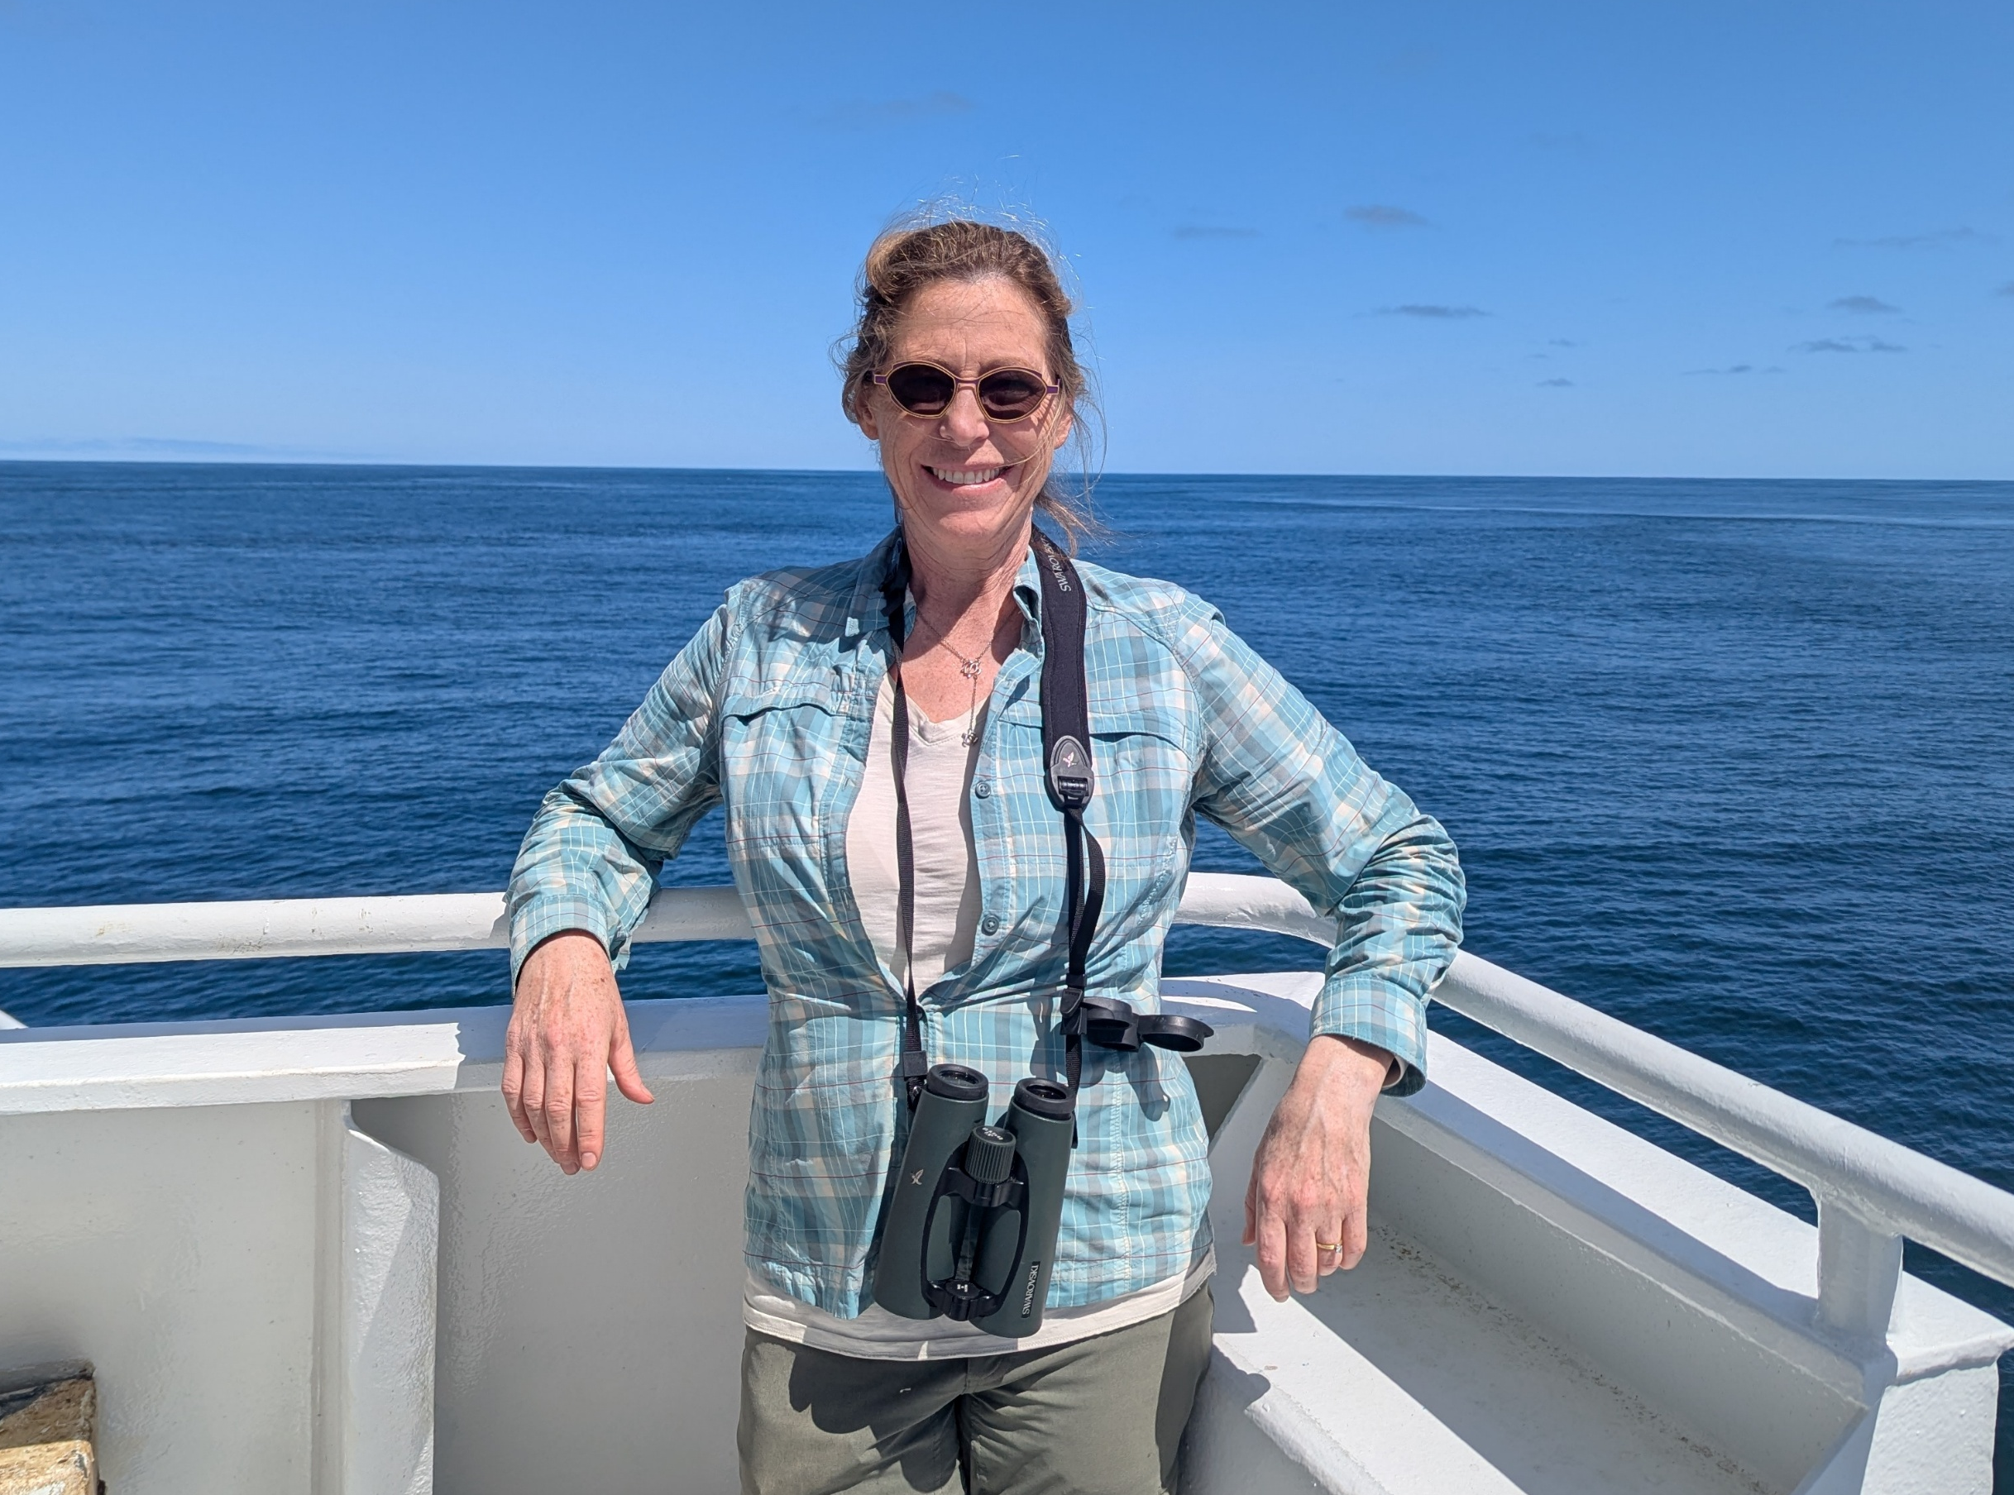
Integrating US and Canadian marine data to identify region-specific limiting factors across a transboundary salmon migration
Lisa Crozier, Cameron Freshwater,
Brian Burke, David Huff, Eric Ward, Doug Jackson and EVE Pugsley
PICES Annual Meeting 2026
Topic Session S12: Transboundary Science for a Changing North Pacific Ocean
Nanaimo, CA
Oct 29, 2026

Slide 2
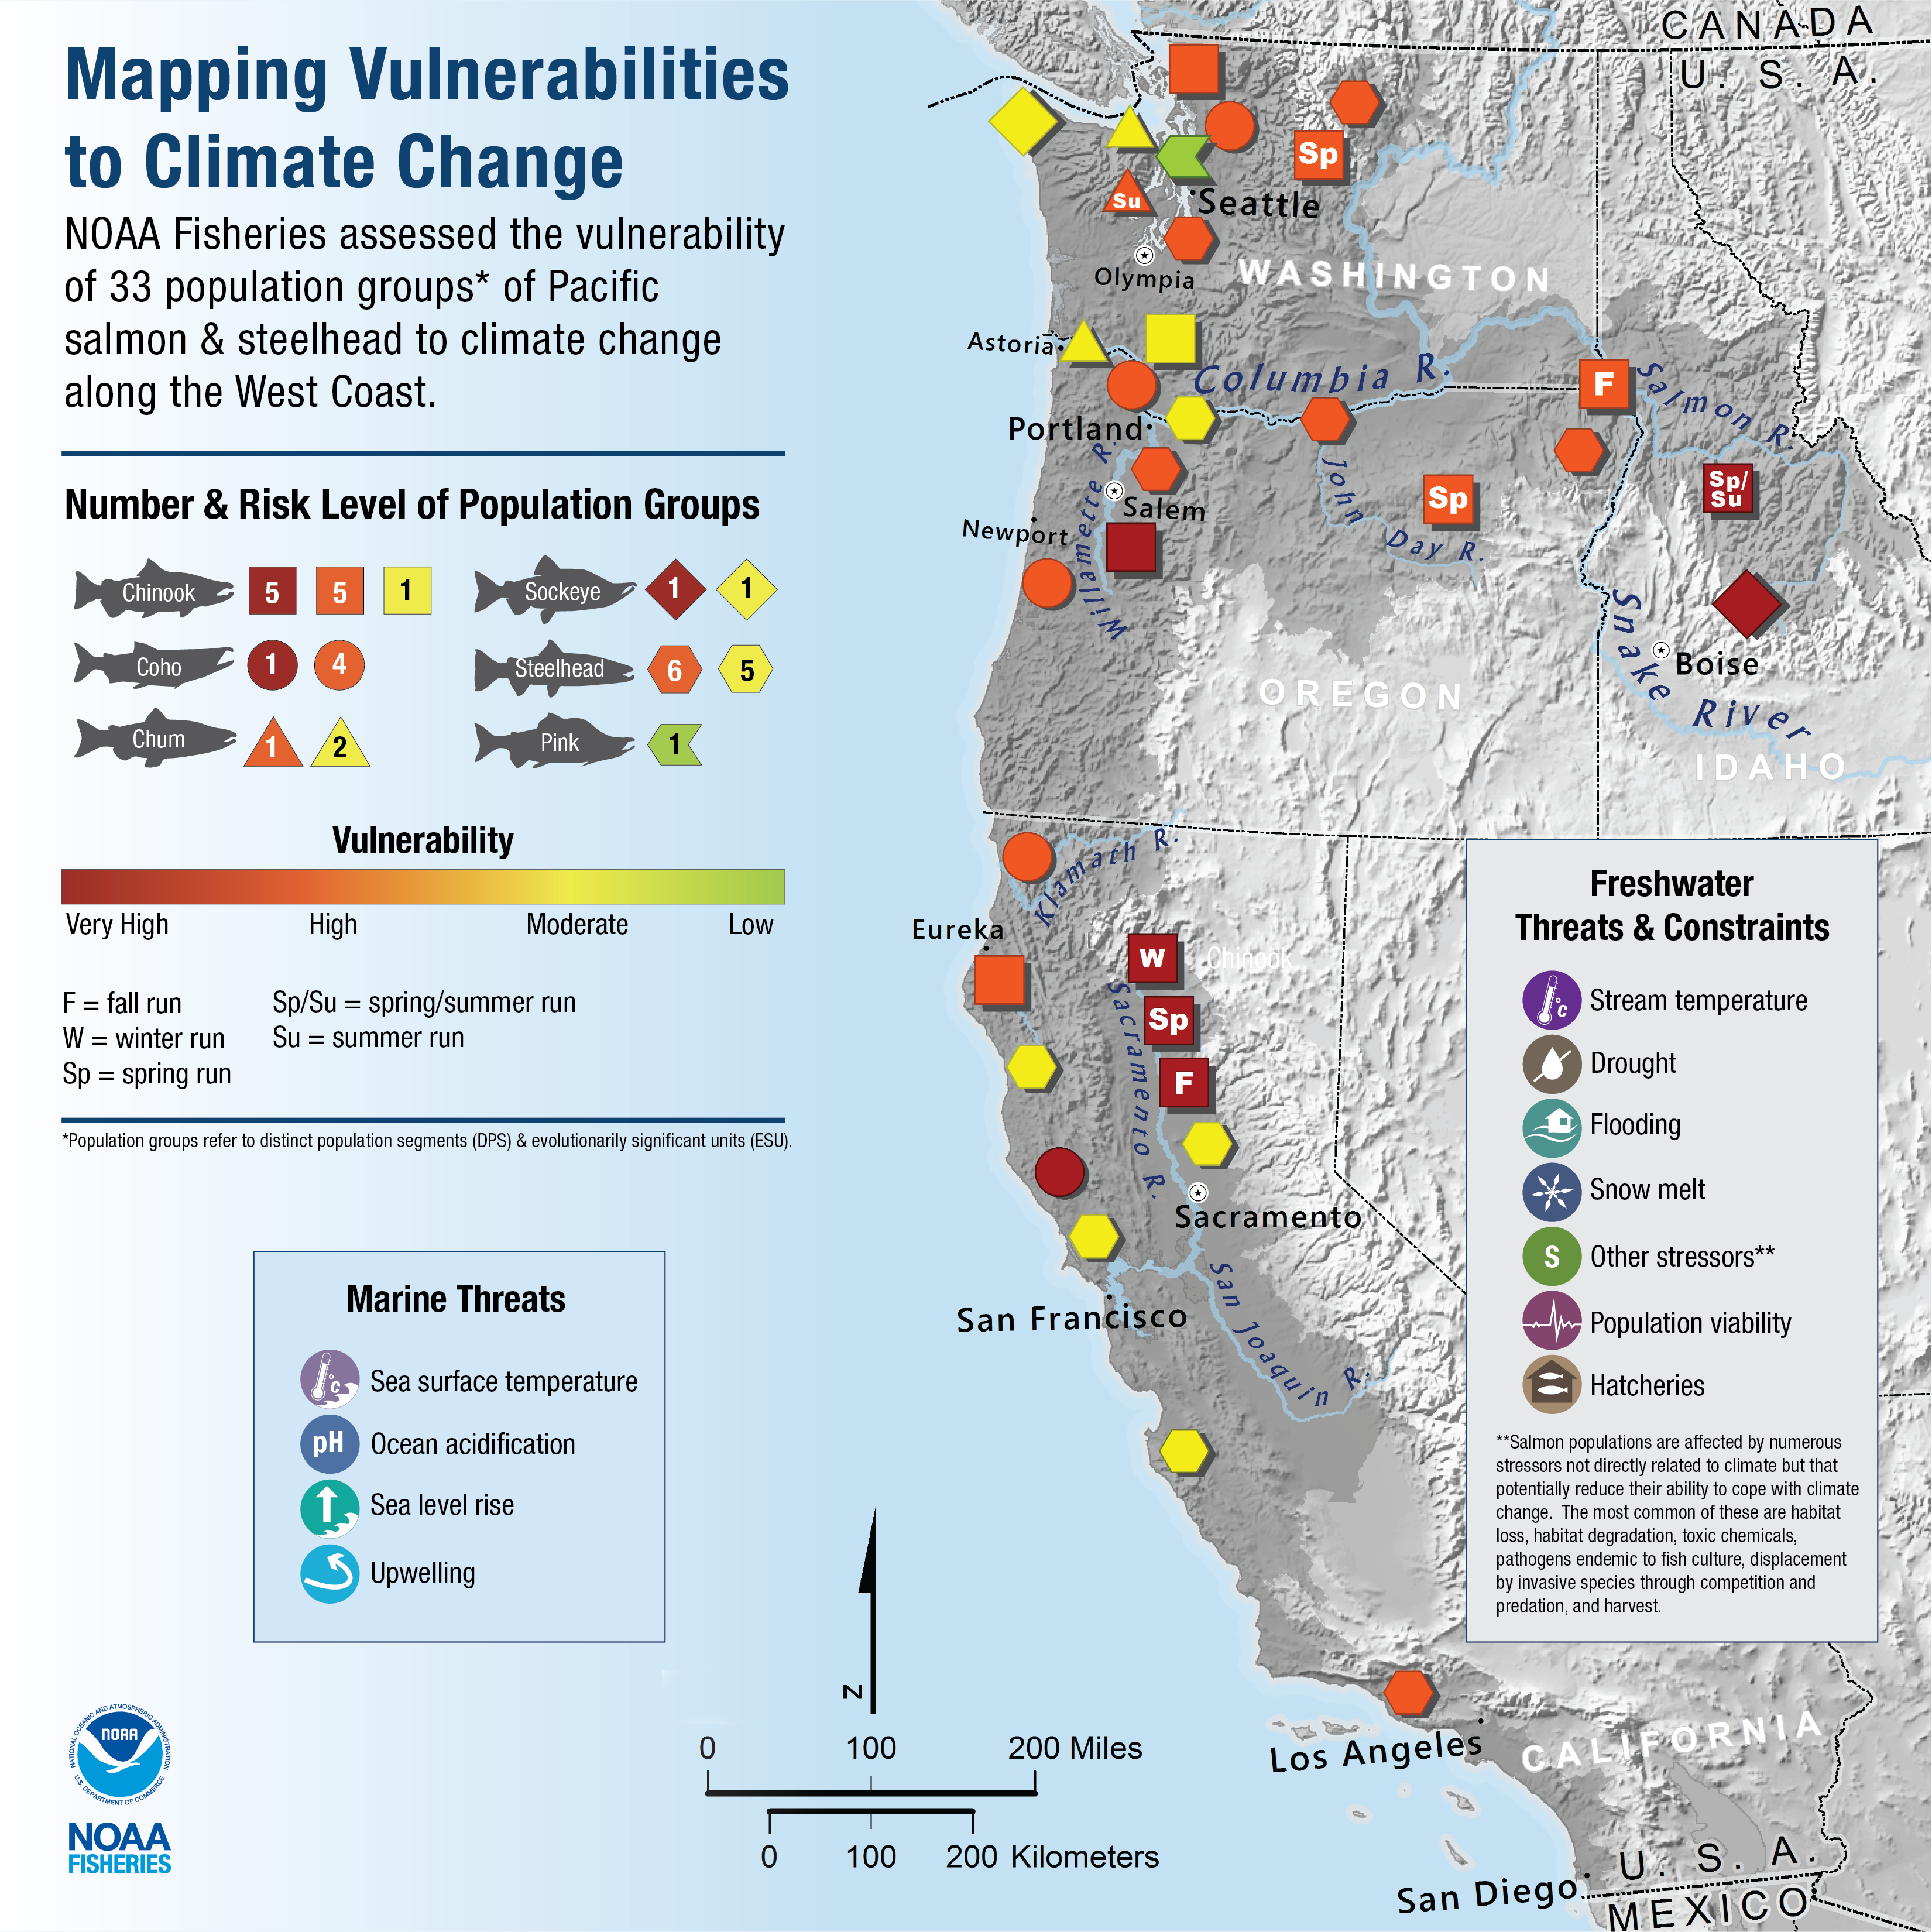
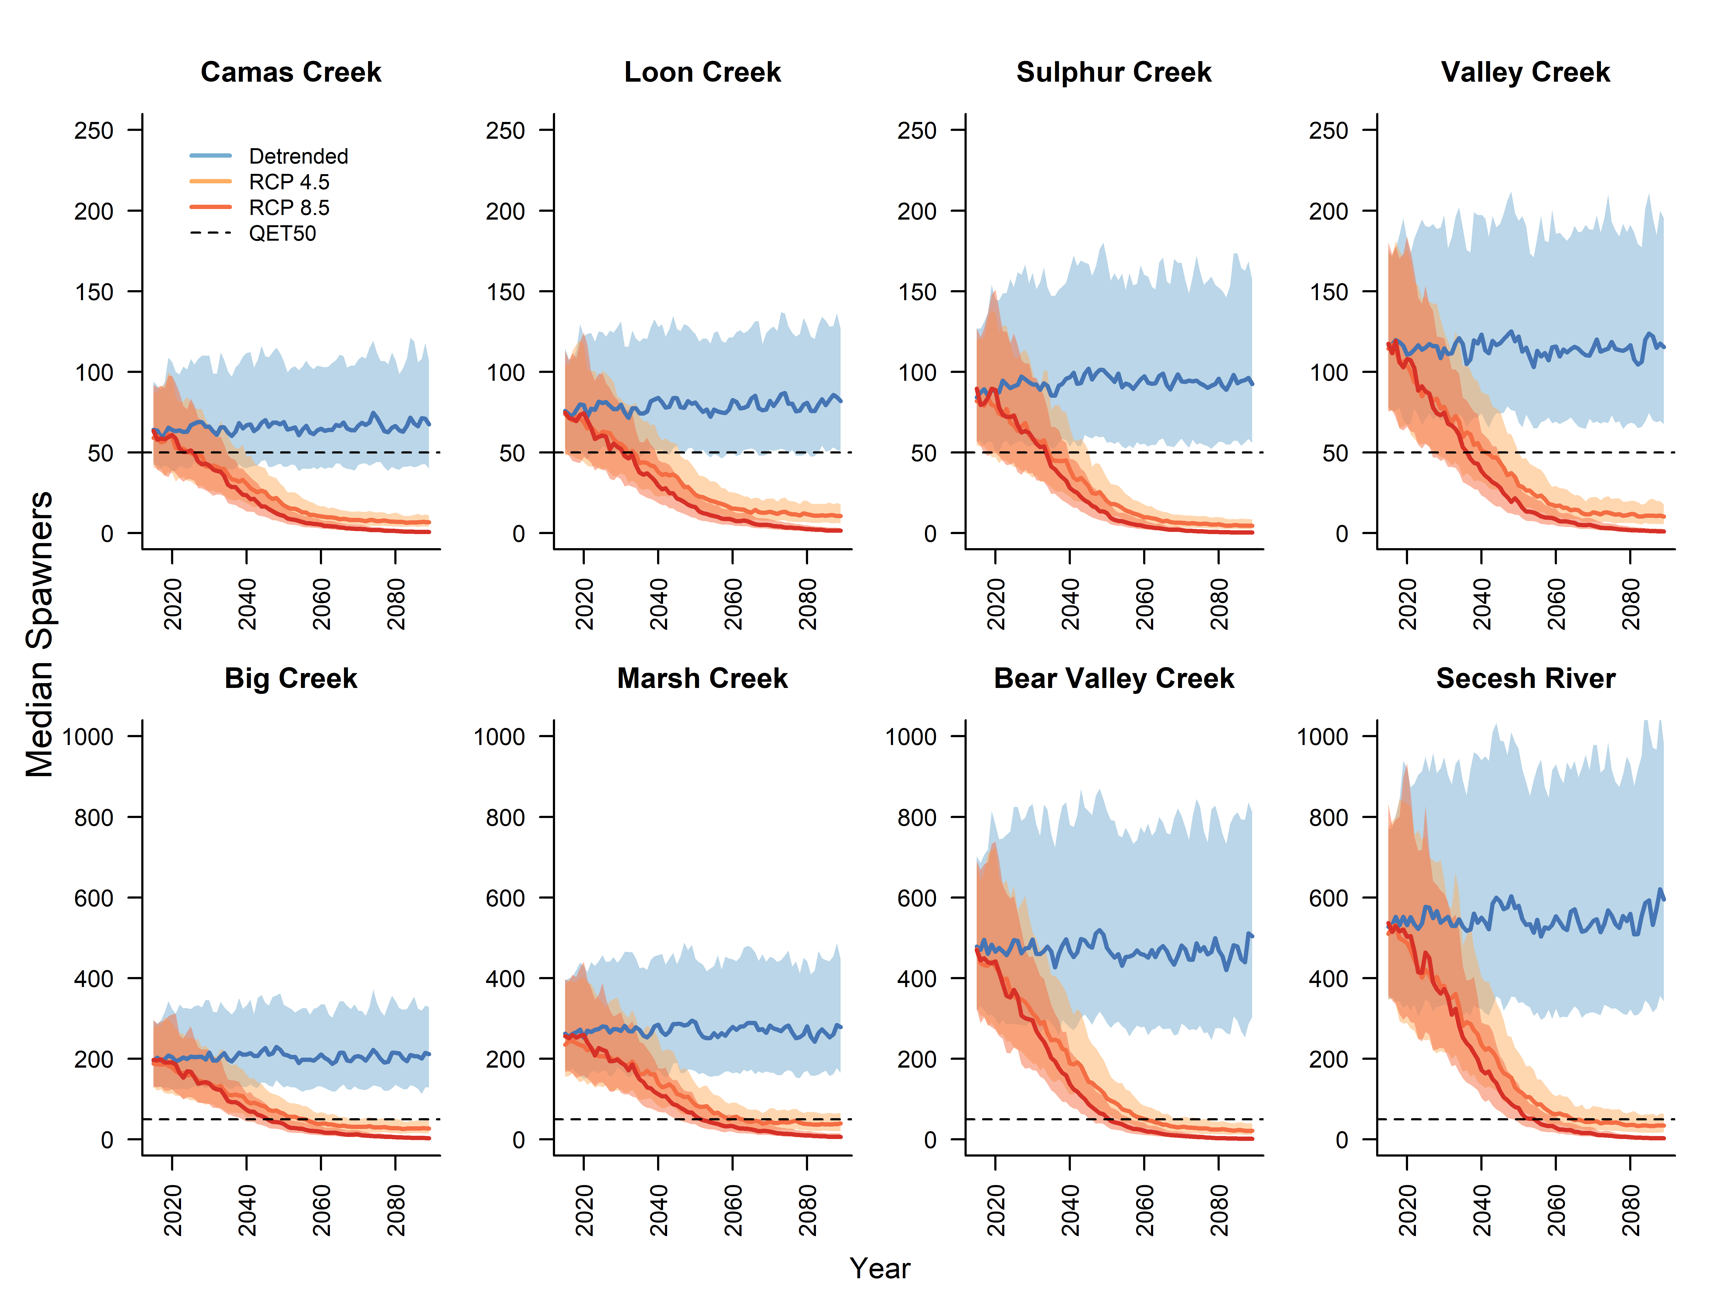
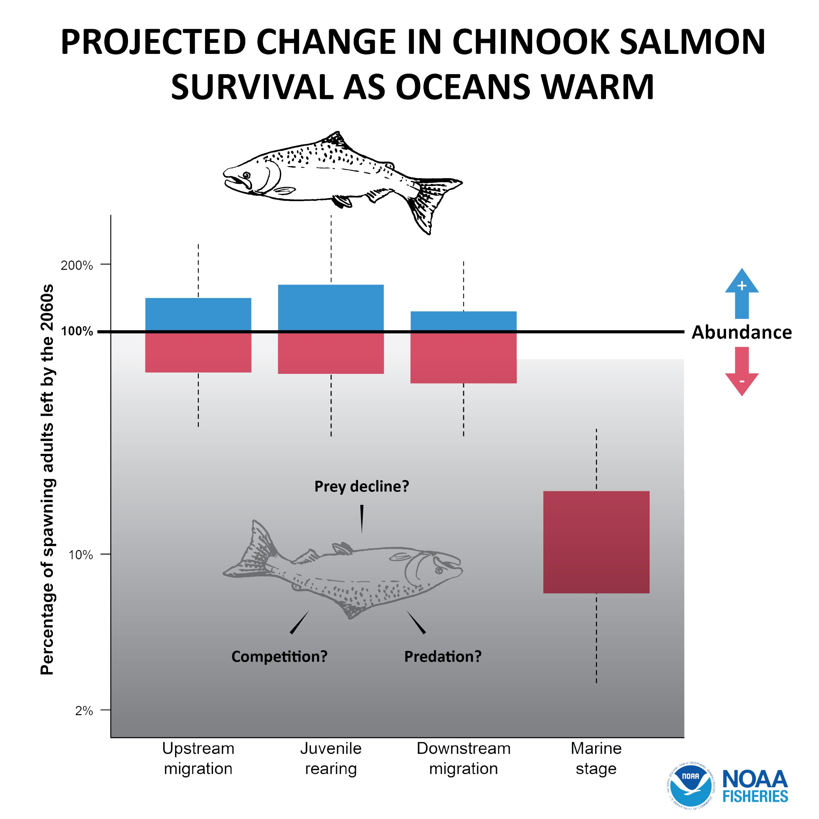
Many species were already endangered, and climate change compounds threat – particularly the marine stage of spring Chinook salmon
Spawners
Winter/spr PDO/SSTarc
Burke et al 2025:
CMISST r²~ 0.5-0.6
Crozier, et al (2021)
https://doi.org/210.1038/s42003-42021-01734-w
Notes:
What motivated me to work on this problem? The map on the left shows the number of salmon populations in the west coast region that are threatened with extinction, and the ones that are in dark red are very highly vulnerable to climate change, the orange ones are highly vulnerable – so for most of them climate change is compounding pre-existing threats. For the group of populations I’ll be talking about today, SRSSC that spawn in the mountains of Idaho and east of the Cascade Mountain Range, the marine stage in particular is much more sensitive to climate change than other life stages. This analysis was based on the strong correlation we see between marine survival and SST. But we know they are not baking to death, they are exposed to higher temperatures in freshwater than even the hottest marine heatwave. And what is most peculiar is that the best predictor of salmon survival is the PDO, or basically GOA temperatures from the winter before they smolt. So there is a lag between the temperatures that predict their mortality and their exposure to these conditions. So it is clear that the ecosystem is mediating this relationship somehow. I wanted to identify possible mechanisms or key interacting species that could theoretically be driving the overall pattern that we are seeing.

Slide 3
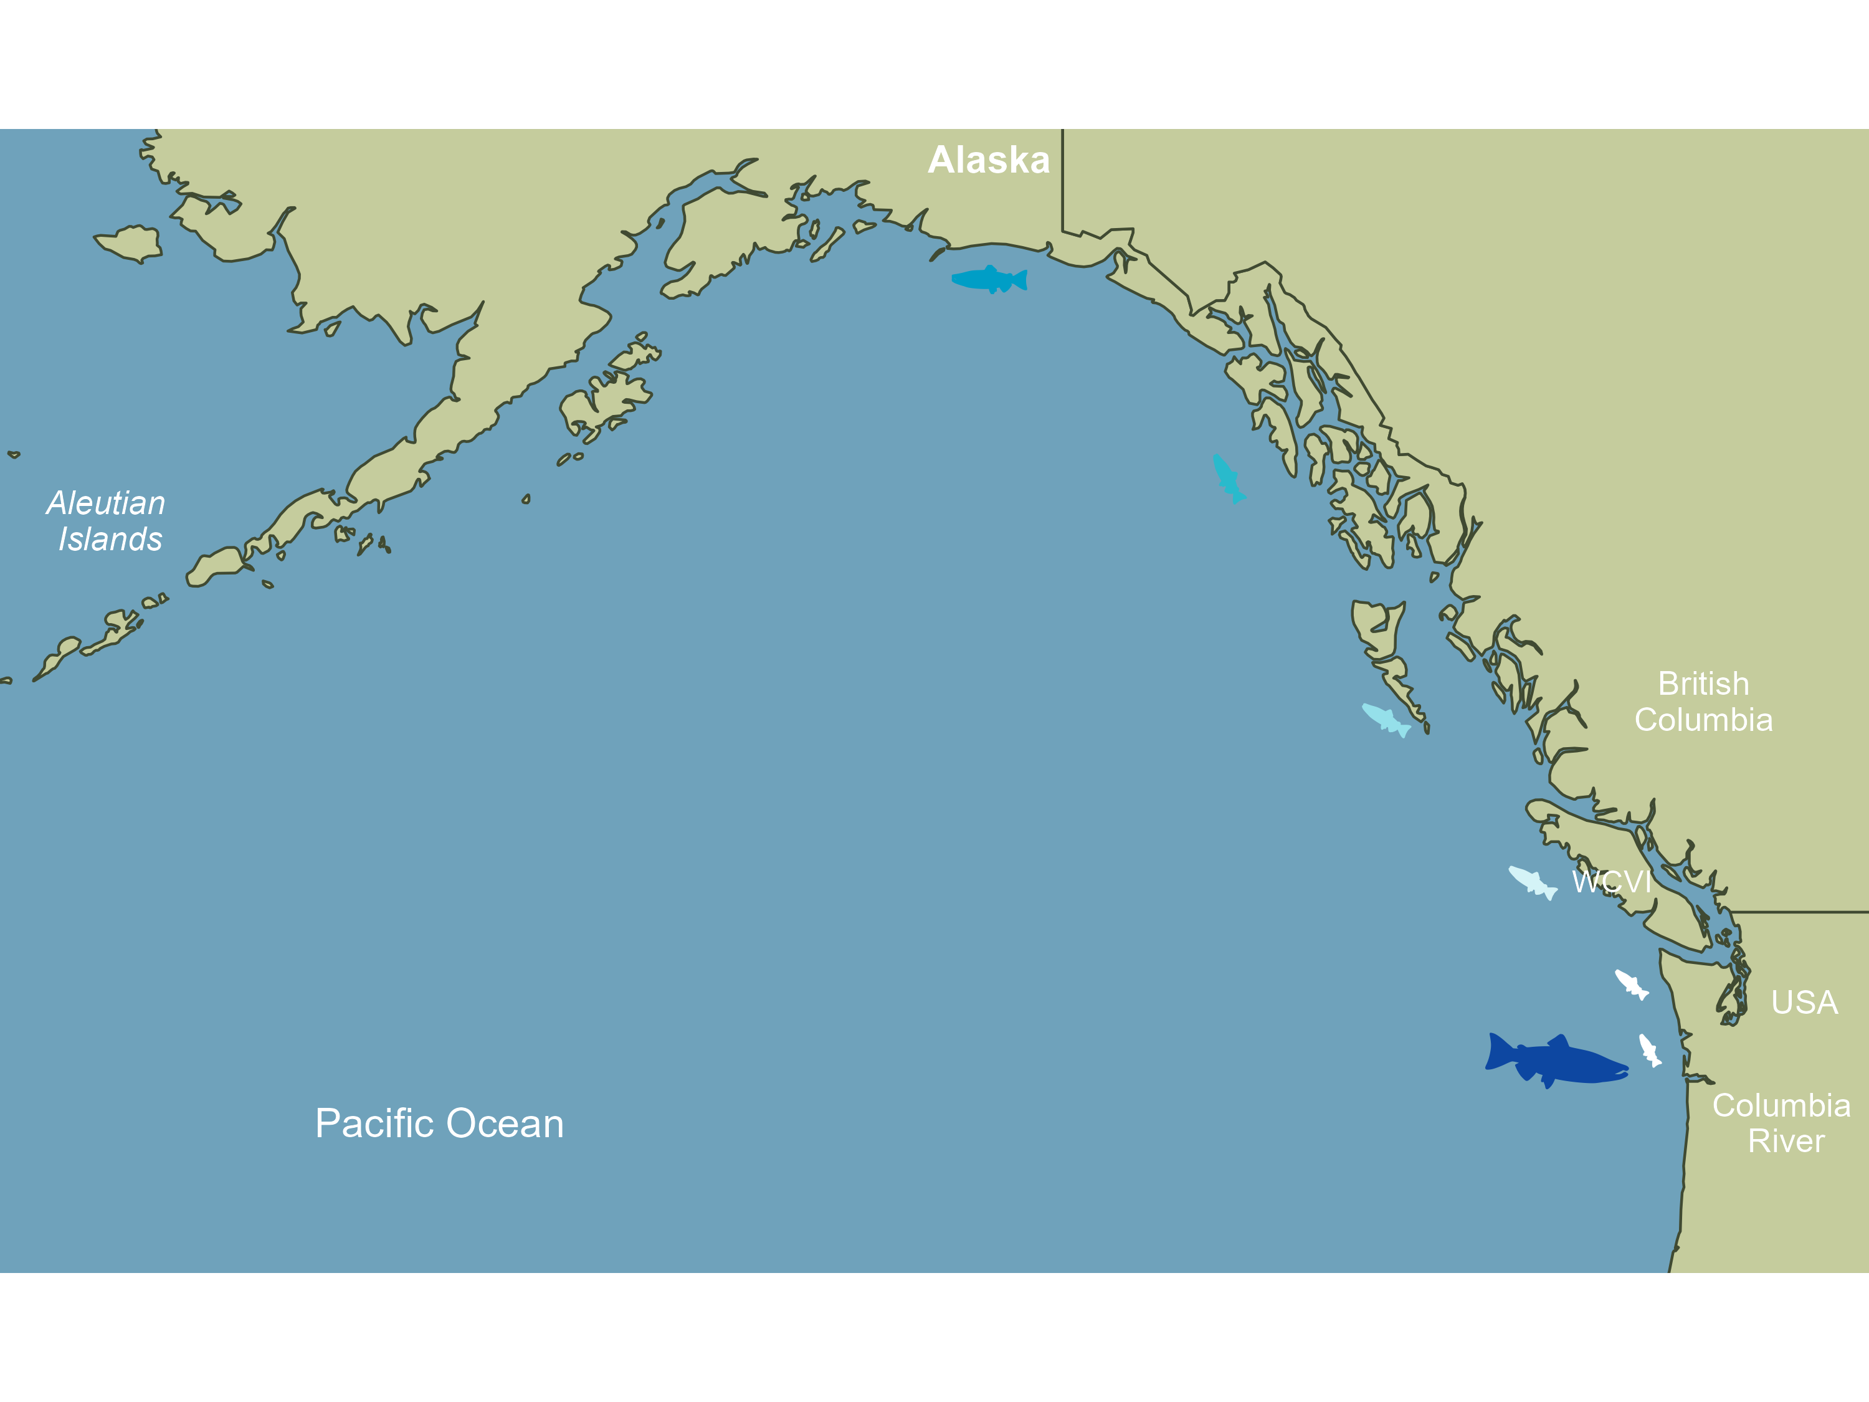
Snake River/
Upper Columbia Spring Chinook
1-3yr in ocean
?
Notes:
So to understand my model let me walk you through what we know about the salmon marine stage. They leave the Columbia river as yearlings in spring, they move quickly up the coast of WA, WCVI, SEAK, and they are caught in juvenile salmon surveys through September in their smolt year. Then 1 or 2 come back to the river a couple years later. And that’s pretty much all we know. We know lots of places they aren’t, because they not caught in any other fishery or during any other surveys in any real numbers.

Slide 4
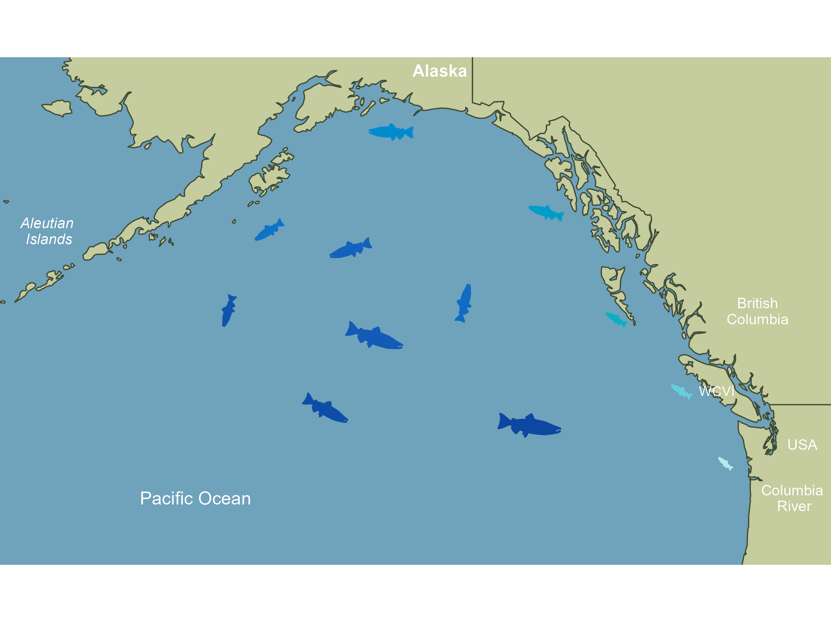
Snake River/
Upper Columbia Spring Chinook
1-3yr in ocean
Notes:
Because of all the places we look but DON’T find them, we surmise that Interior Columbia spring Chinook salmon move further off the coast and drop deeper in the mid water than other juvenile salmon. But we really don’t know exactly where they are. So I’m assuming they could interact with a large number of other species.

Slide 5
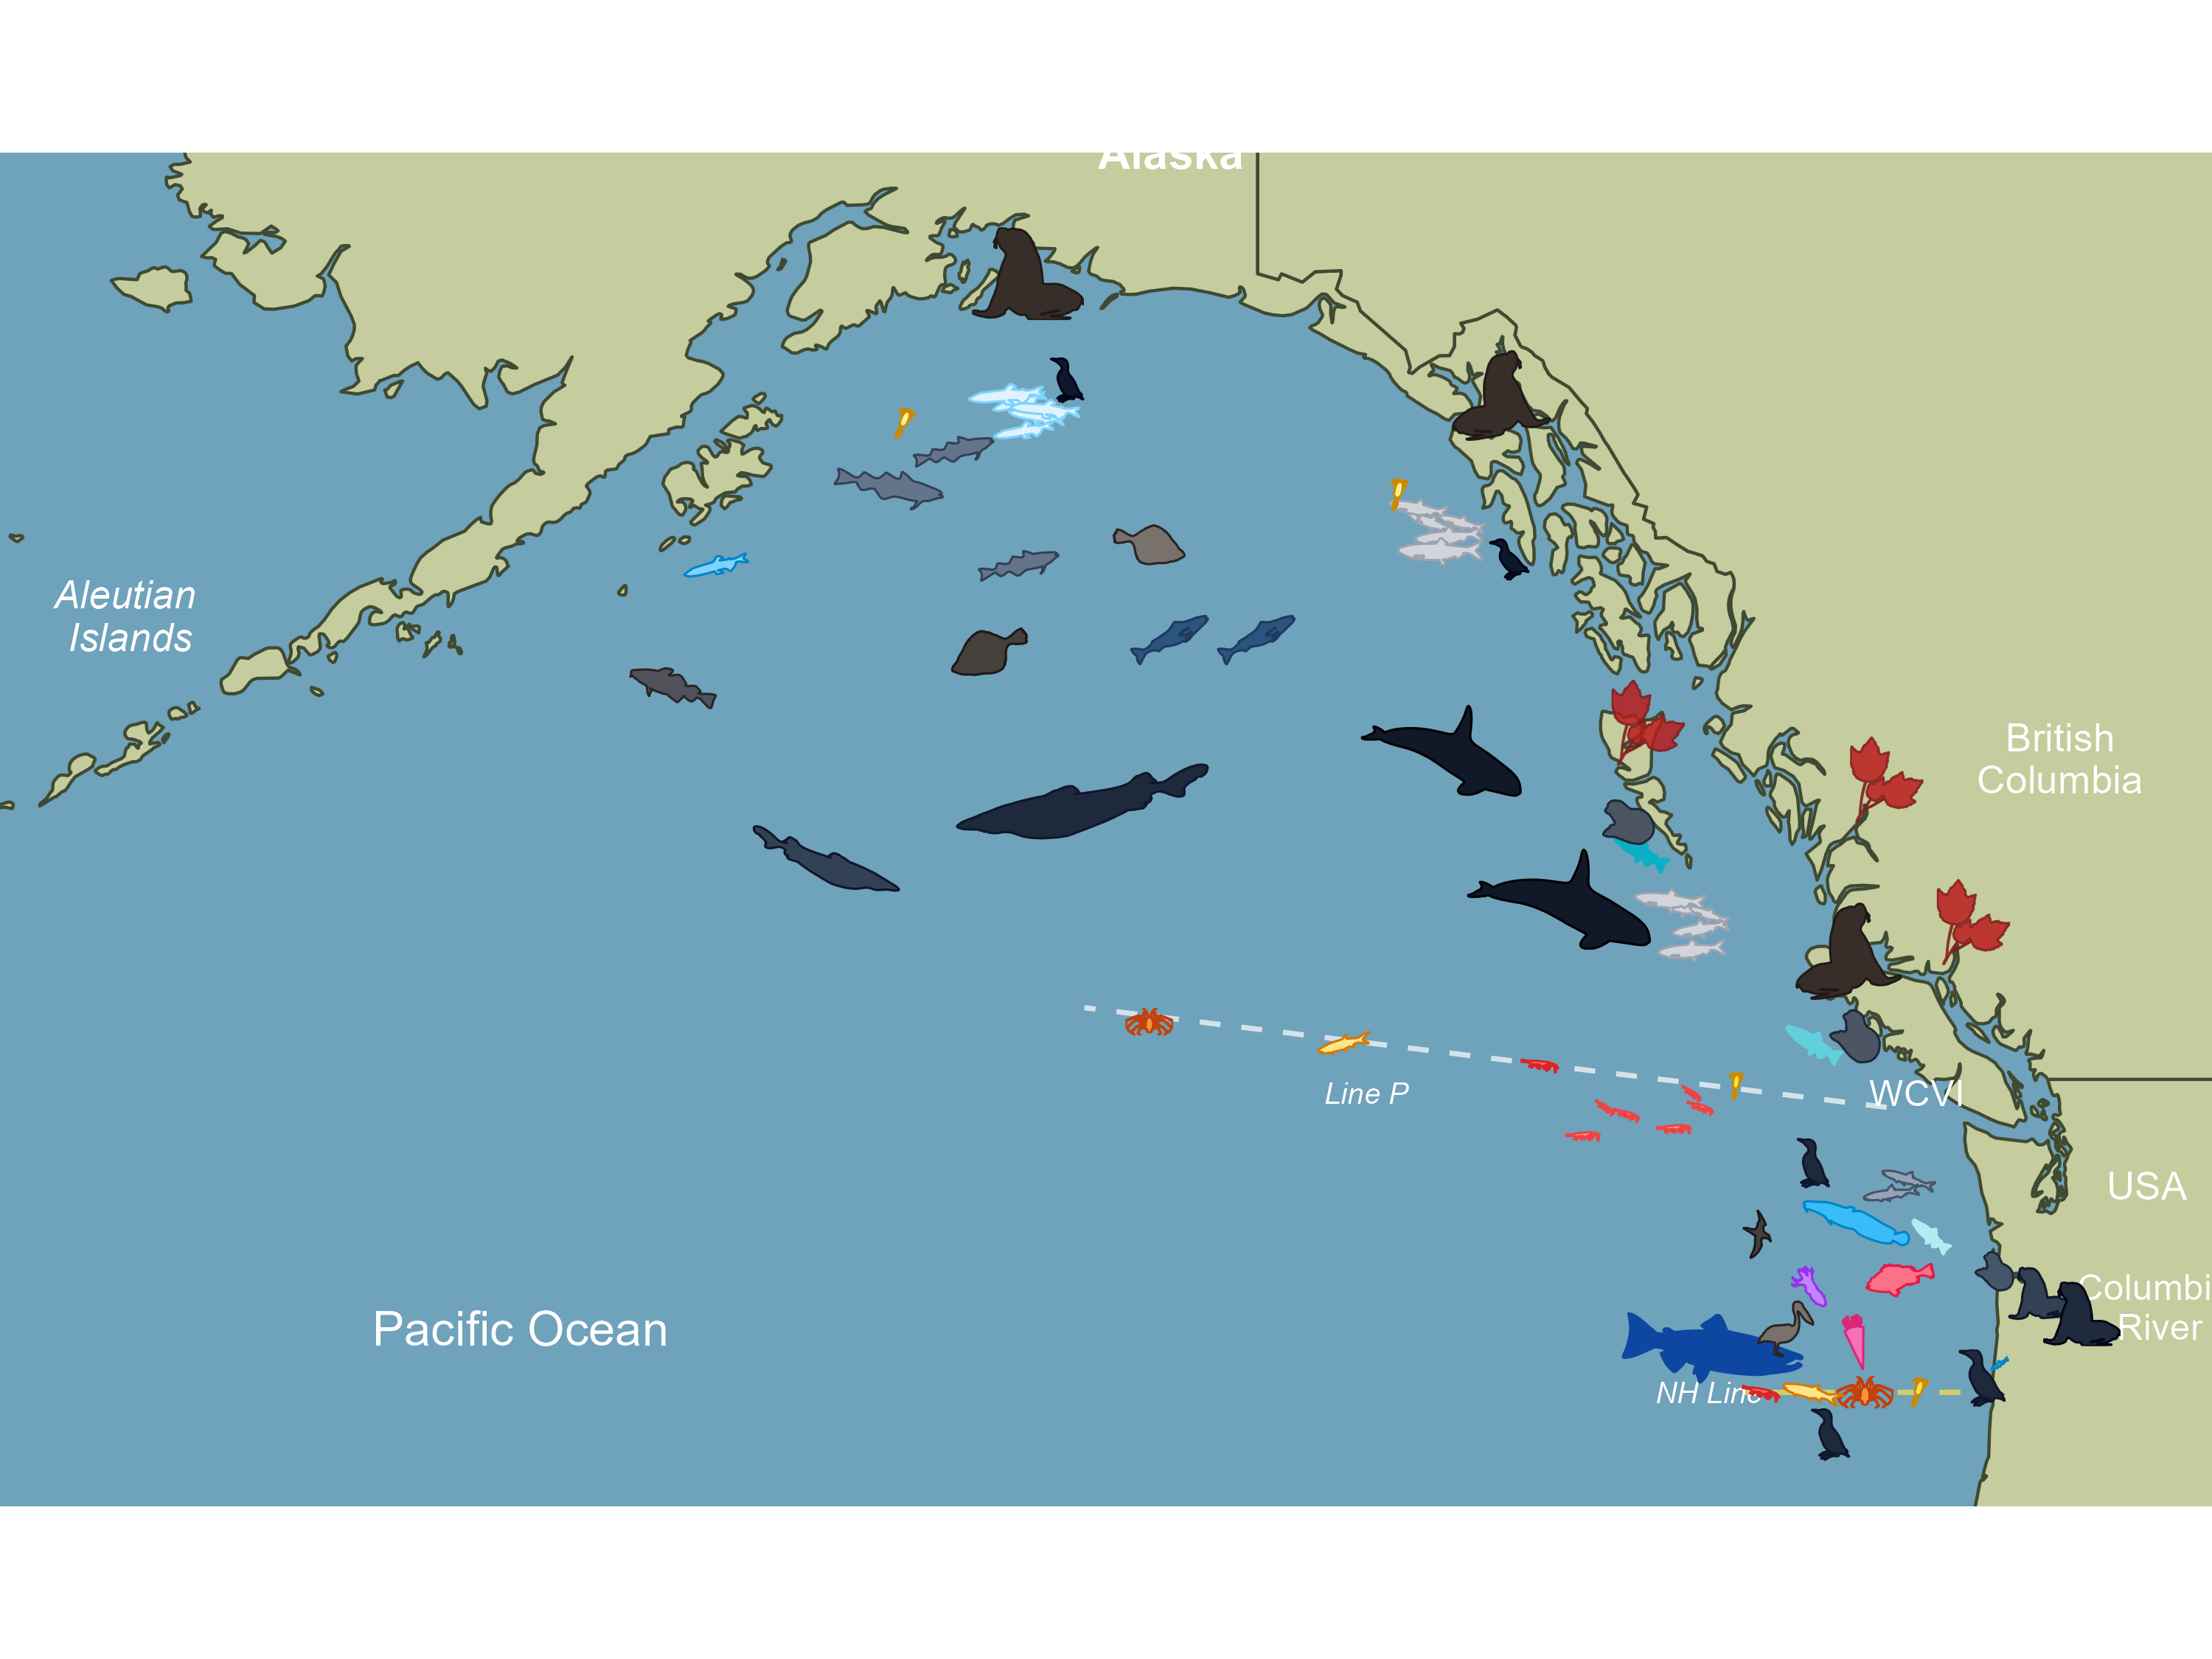
Final model
133 indicators
27 sub-guilds
(latent variables, e.g., pisciv. birds in NCC)
6 trophic/region nodes
AK: 35 series
BC: 37 series
WA: 83 series

Slide 6
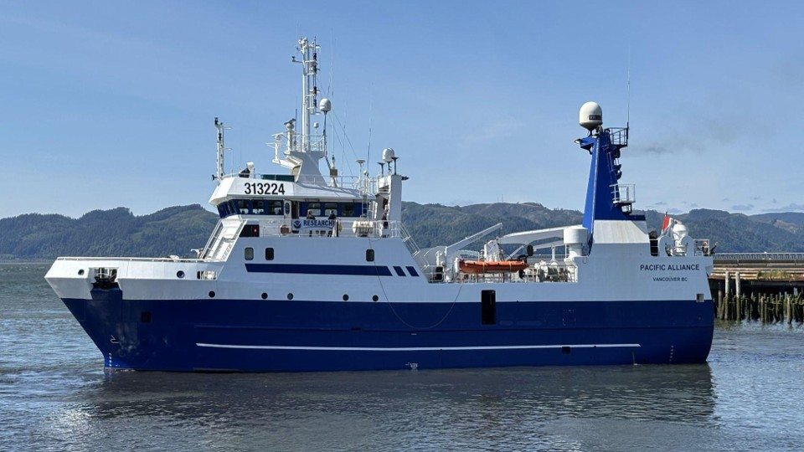
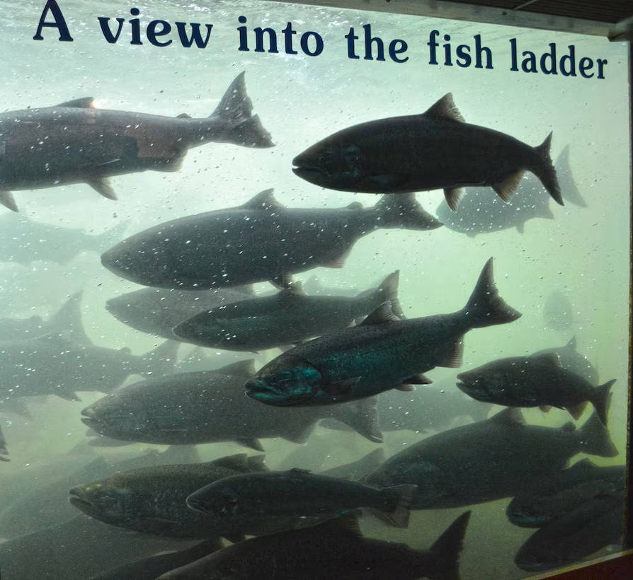
Structural Equation Model Approach
H1
Early marine stage:
<June smolt mig yr
Data from
JSOES survey
Marine Growth Rate
(IGF + stomach fullness
or fork length)
PreyNCC
PredatorsNCC
Early Marine Survival
(cpue June JSOES survey +
sdmTMB modeled abundance)
JSOES survey 2025
Smolt to Adult Return
(BON-BON, pittagged SR+UC)
Late marine stage:
>June smolt mig yr
Data from
BC/AK surveys
Columbia River mammals
PreyAK
PredatorsAK
Photo: usace.army.mil
Notes:
Our ultimate goal is to predict SAR from biological indices rather than climatic indices. And we want to do that by partitioning total marine survival into early and later stages.
All components of the model are smoothed using either a DFA to combine potential latent variables or a MARSS model for single variables. This is part of the “fair test” requirement for this phase
We tested this hypothesis by comparing two model structures.
In the first, a number of different possible indices of growth were modeled as predictors of early marine survival, measured using both the cpue directly from the JSOES survey as well as a modeled abundance from a spatiotemporal model that accounts for slight variations from year to year in the survey
Our response variable is the combined SAR
Here are 2 structures we explored – growth -> abundance -> SAR
Growth->SAR & Abund -> SAR
The idea was to compare model structures by aic
But also to identify the best predictors a
Size to cpue
Size selective predation, gape-limited predation
Prey-switching of predator – predators eating more other prey (buffer)

Slide 7
Structural Equation Model Approach
H1
H2
Early marine stage:
<June smolt mig yr
Data from
JSOES survey
Early Growth
PreyNCC
PreyNCC
PredatorsNCC
?
?
Early Growth
Early Survival
PredatorsNCC
?
Early Marine Survival
?
Smolt to Adult Return
Smolt to Adult Return
Late marine stage:
>June smolt mig yr
Data from
BC/AK surveys
Columbia River mammals
?
PreyAK
PreyAK
?
PredatorsAK
PredatorsAK
Photo: usace.army.mil
Notes:
Our ultimate goal is to predict SAR from biological indices rather than climatic indices. And we want to do that by partitioning total marine survival into early and later stages.
All components of the model are smoothed using either a DFA to combine potential latent variables or a MARSS model for single variables. This is part of the “fair test” requirement for this phase
We tested this hypothesis by comparing two model structures.
In the first, a number of different possible indices of growth were modeled as predictors of early marine survival, measured using both the cpue directly from the JSOES survey as well as a modeled abundance from a spatiotemporal model that accounts for slight variations from year to year in the survey
Our response variable is the combined SAR
Here are 2 structures we explored – growth -> abundance -> SAR
Growth->SAR & Abund -> SAR
The idea was to compare model structures by aic
But also to identify the best predictors a
Size to cpue
Size selective predation, gape-limited predation
Prey-switching of predator – predators eating more other prey (buffer)

Slide 8
Goals
Identify viable models to reduce the number of candidate indices
Test hypotheses:
Bigger is better
(bottom-up regulation)
Predator abundance drives salmon survival
(top-down regulation)
Conditions modulate predator impact
(top-down modulated)

Slide 9
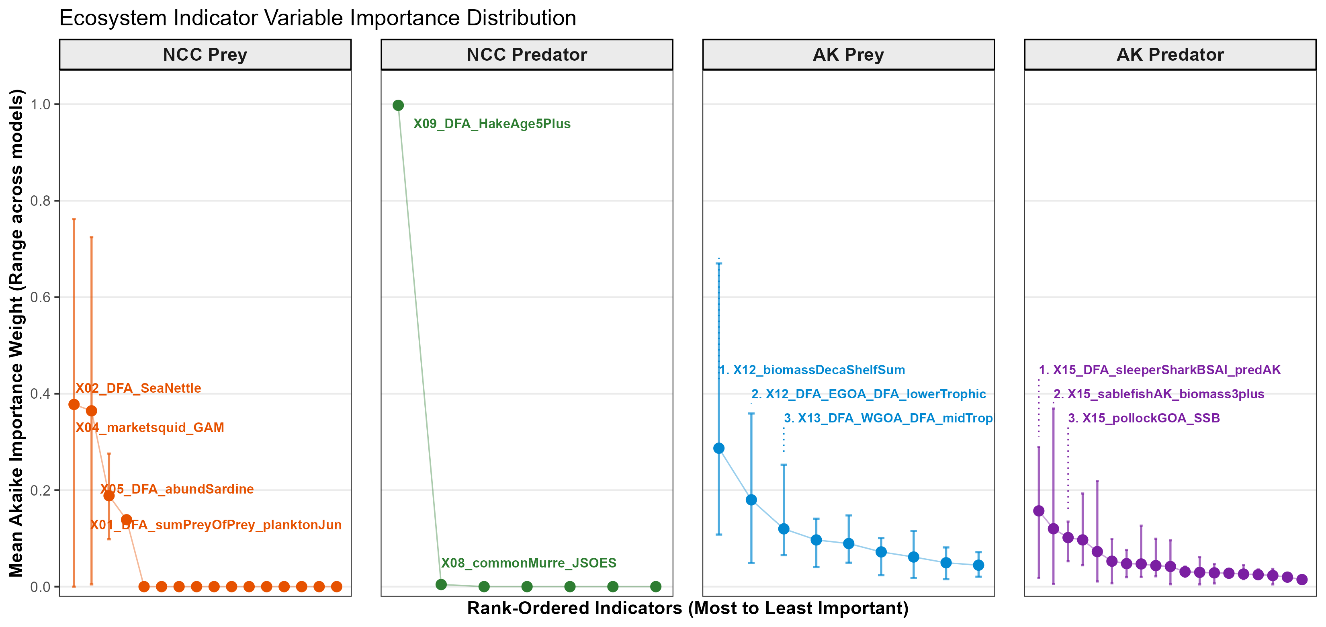
Goal 1 – YES!!!
A few predictors dominated results
X09_Piscivorous Fish:
Hake age 5+
WA Hake spring fishery
Jack Mackerel
Pacific Mackerel
Misc rockfish
X12_WCVI plankton prey
X15_SleeperShark
X02_Gelatinous
4. X10_Harbour_s_WS_adultyr
X05_Sardine, herring, anchovy

Slide 10
Goal 2 regulation hypo -- sometimes
Summary of coefficients in all models with dAIC<3
YES – 100% significant,
100% neg
Early Growth
PreyNCC
PreyNCC
PredatorsNCC
NO -- 0% significant
Early Growth
Early Survival
PredatorsNCC
YES –
100% significant,
100% neg
Early Marine Survival
YES –
59% significant,
70% pos
Smolt to Adult Return
Smolt to Adult Return
PreyAK
PreyAK
SOMETIMES –
64% significant, 55% neg
PredatorsAK
PredatorsAK
Photo: usace.army.mil
Notes:
Goal 2 was to test our bottom up and top down regulation hypotheses.
For bigger is better we saw no support for that within the early marine stage, but early growth was a sign predictor of SAR ~60% of the time – note that only 70% of the coef were positive. So – sometimes bigger seems to be better, but it isn’t totally consistent
We saw extremely strong support for piscivorous fish, specifically hake and jack/pacific mackerel being negatively correlated with early marine salmon survival.
In AK, top-down effects were more ambiguous, only about half of the models produced neg coef for this link. So something else might be going on in this life stage.

Slide 11
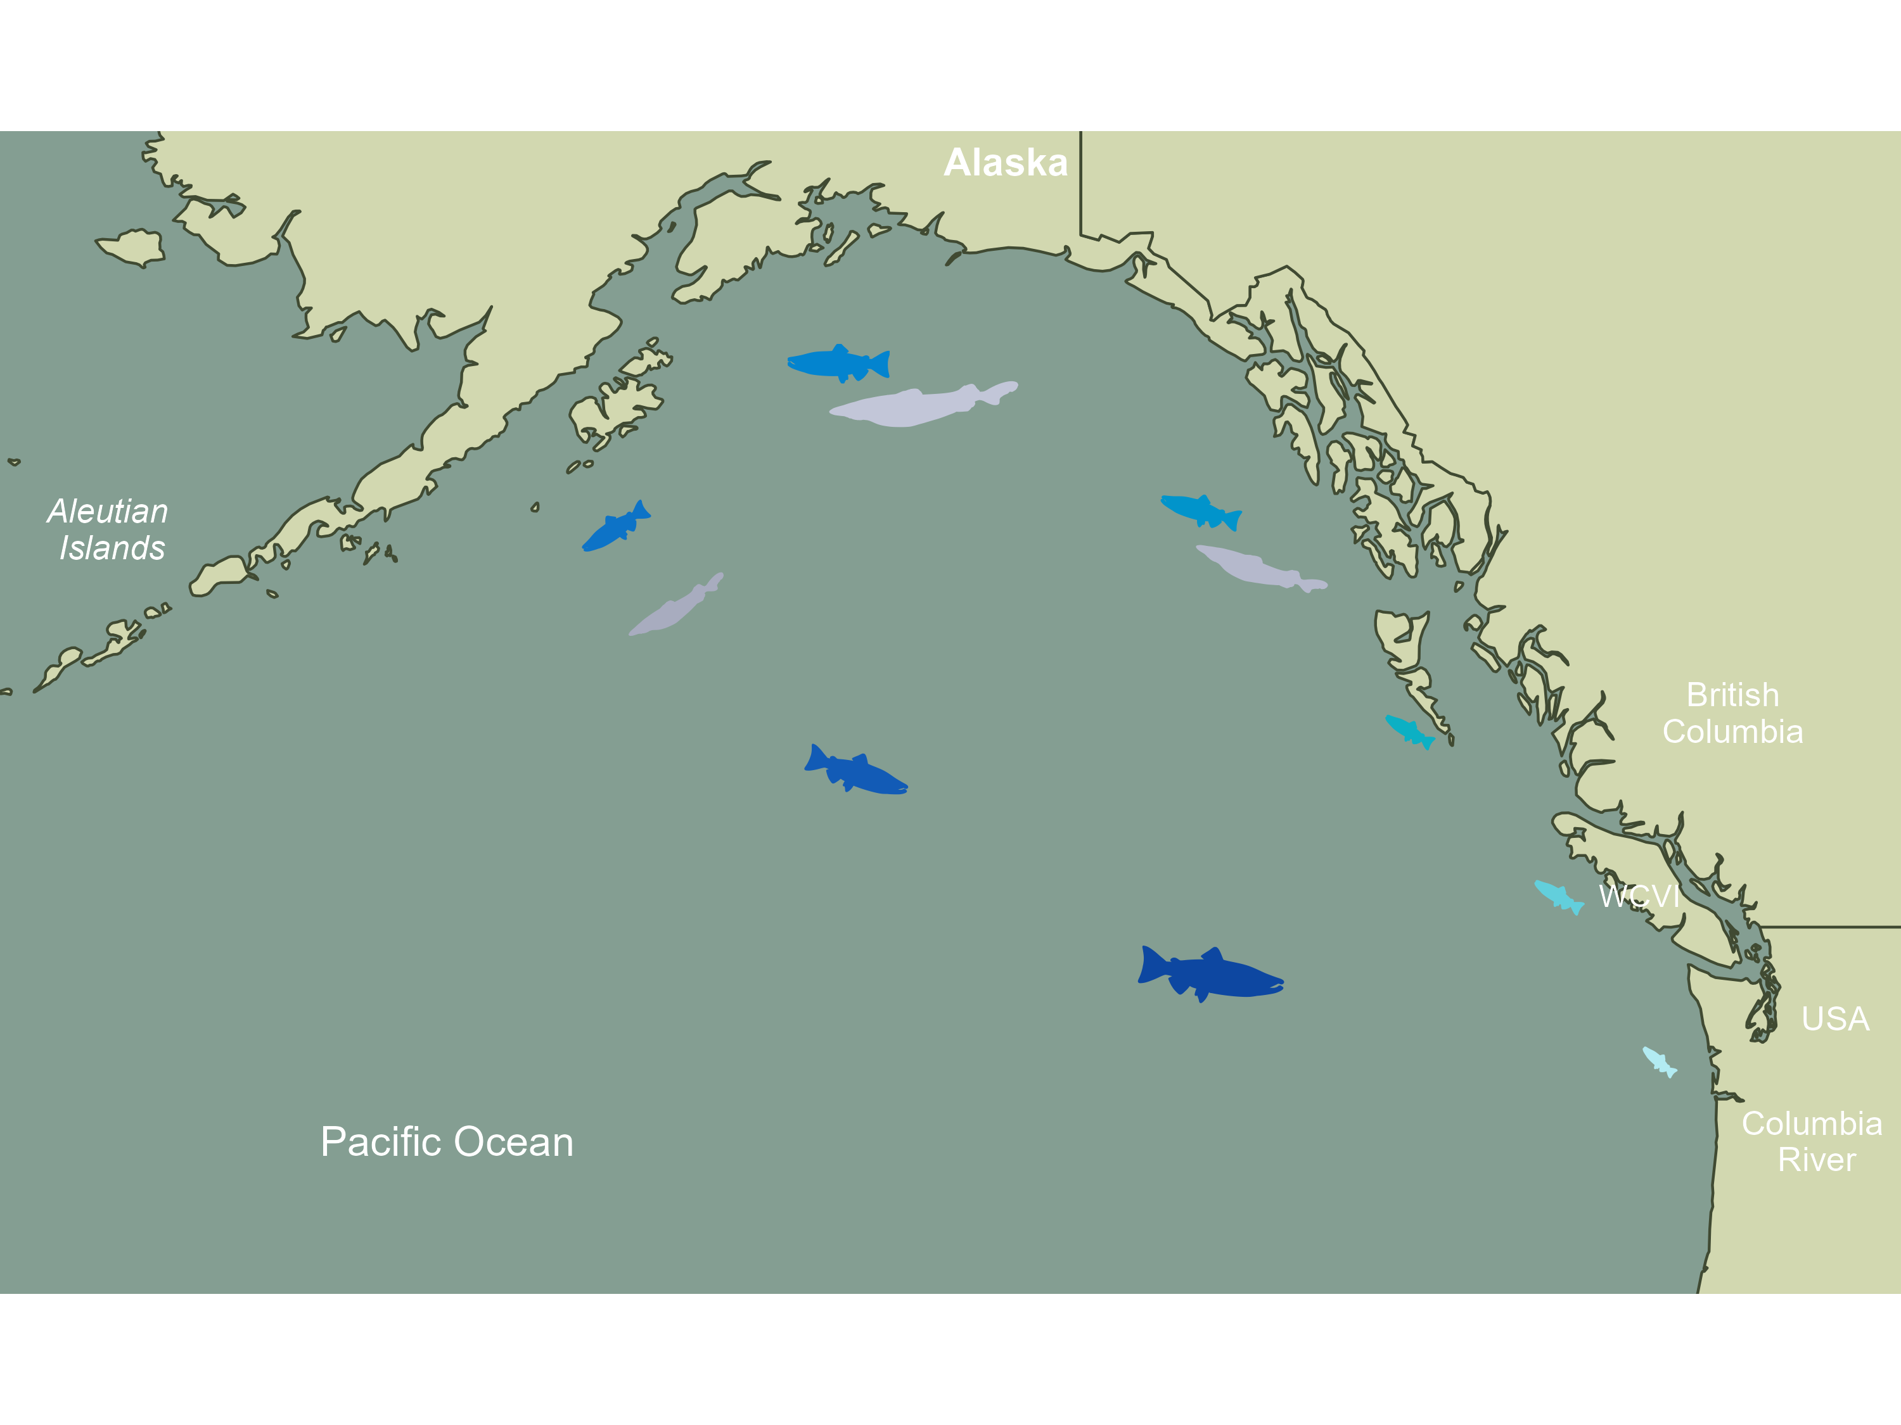

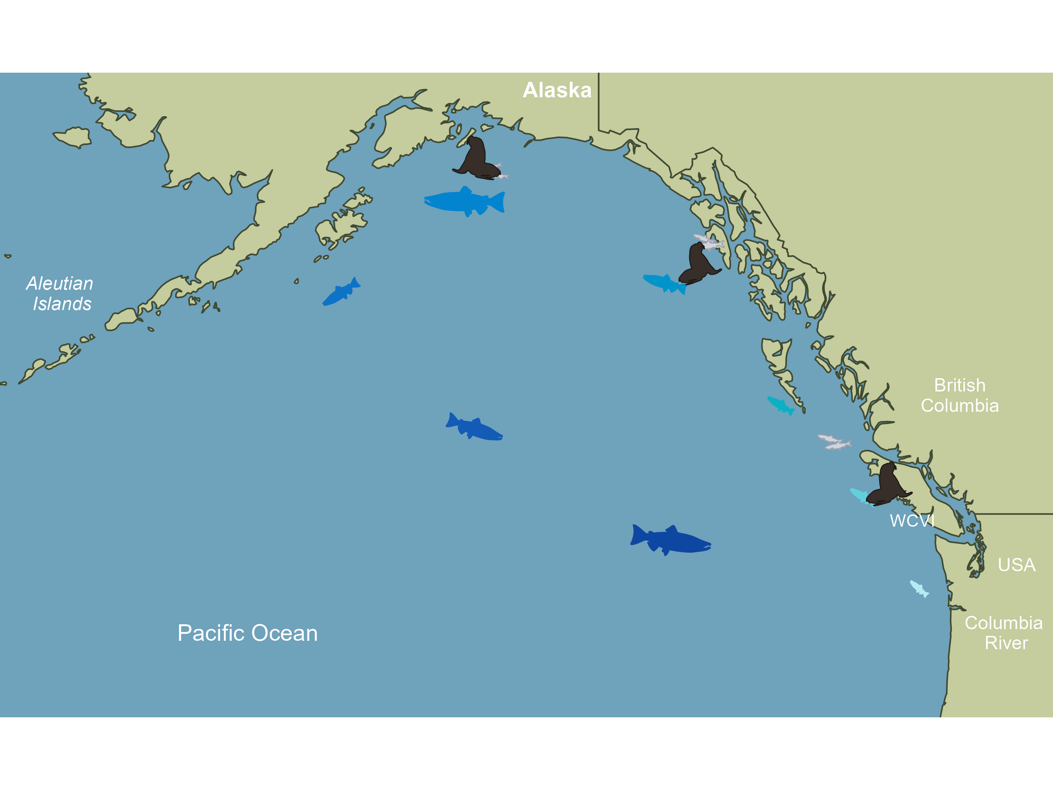
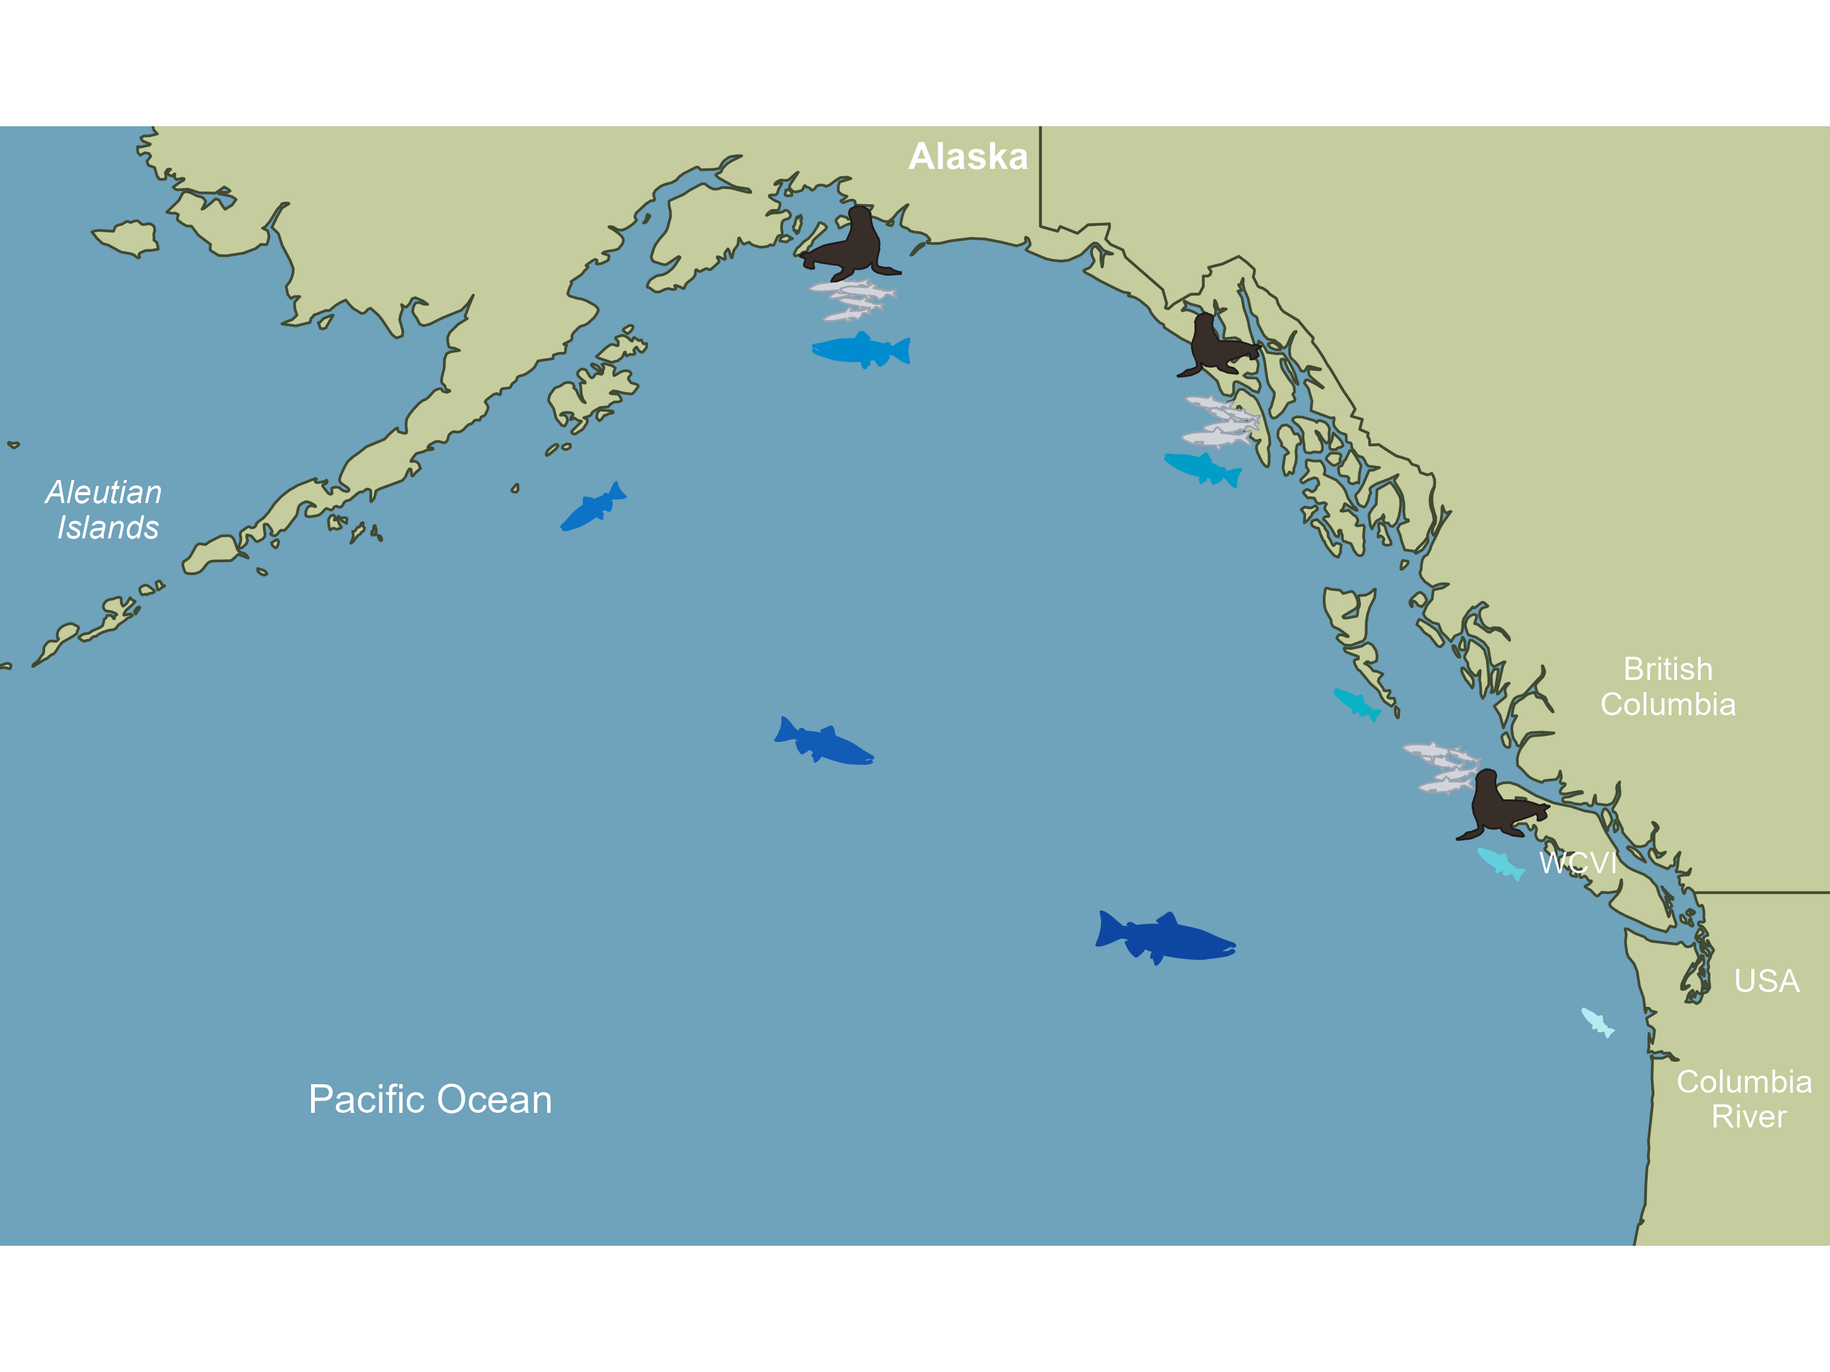
Goal 3
Explore modulated predator impacts
H1: temperature->spatial overlap
H2: alternate prey->prey switching

Slide 12
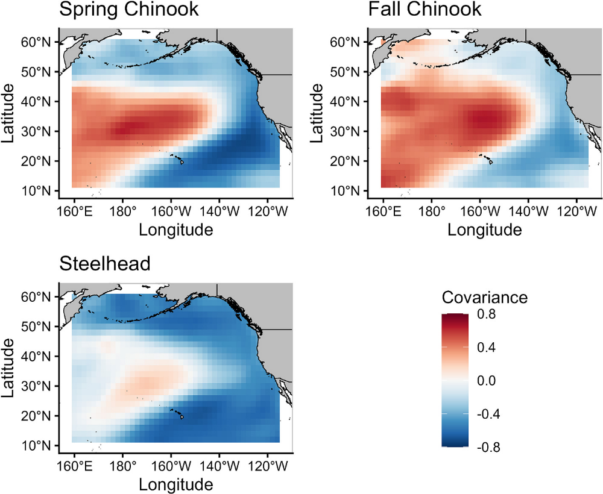
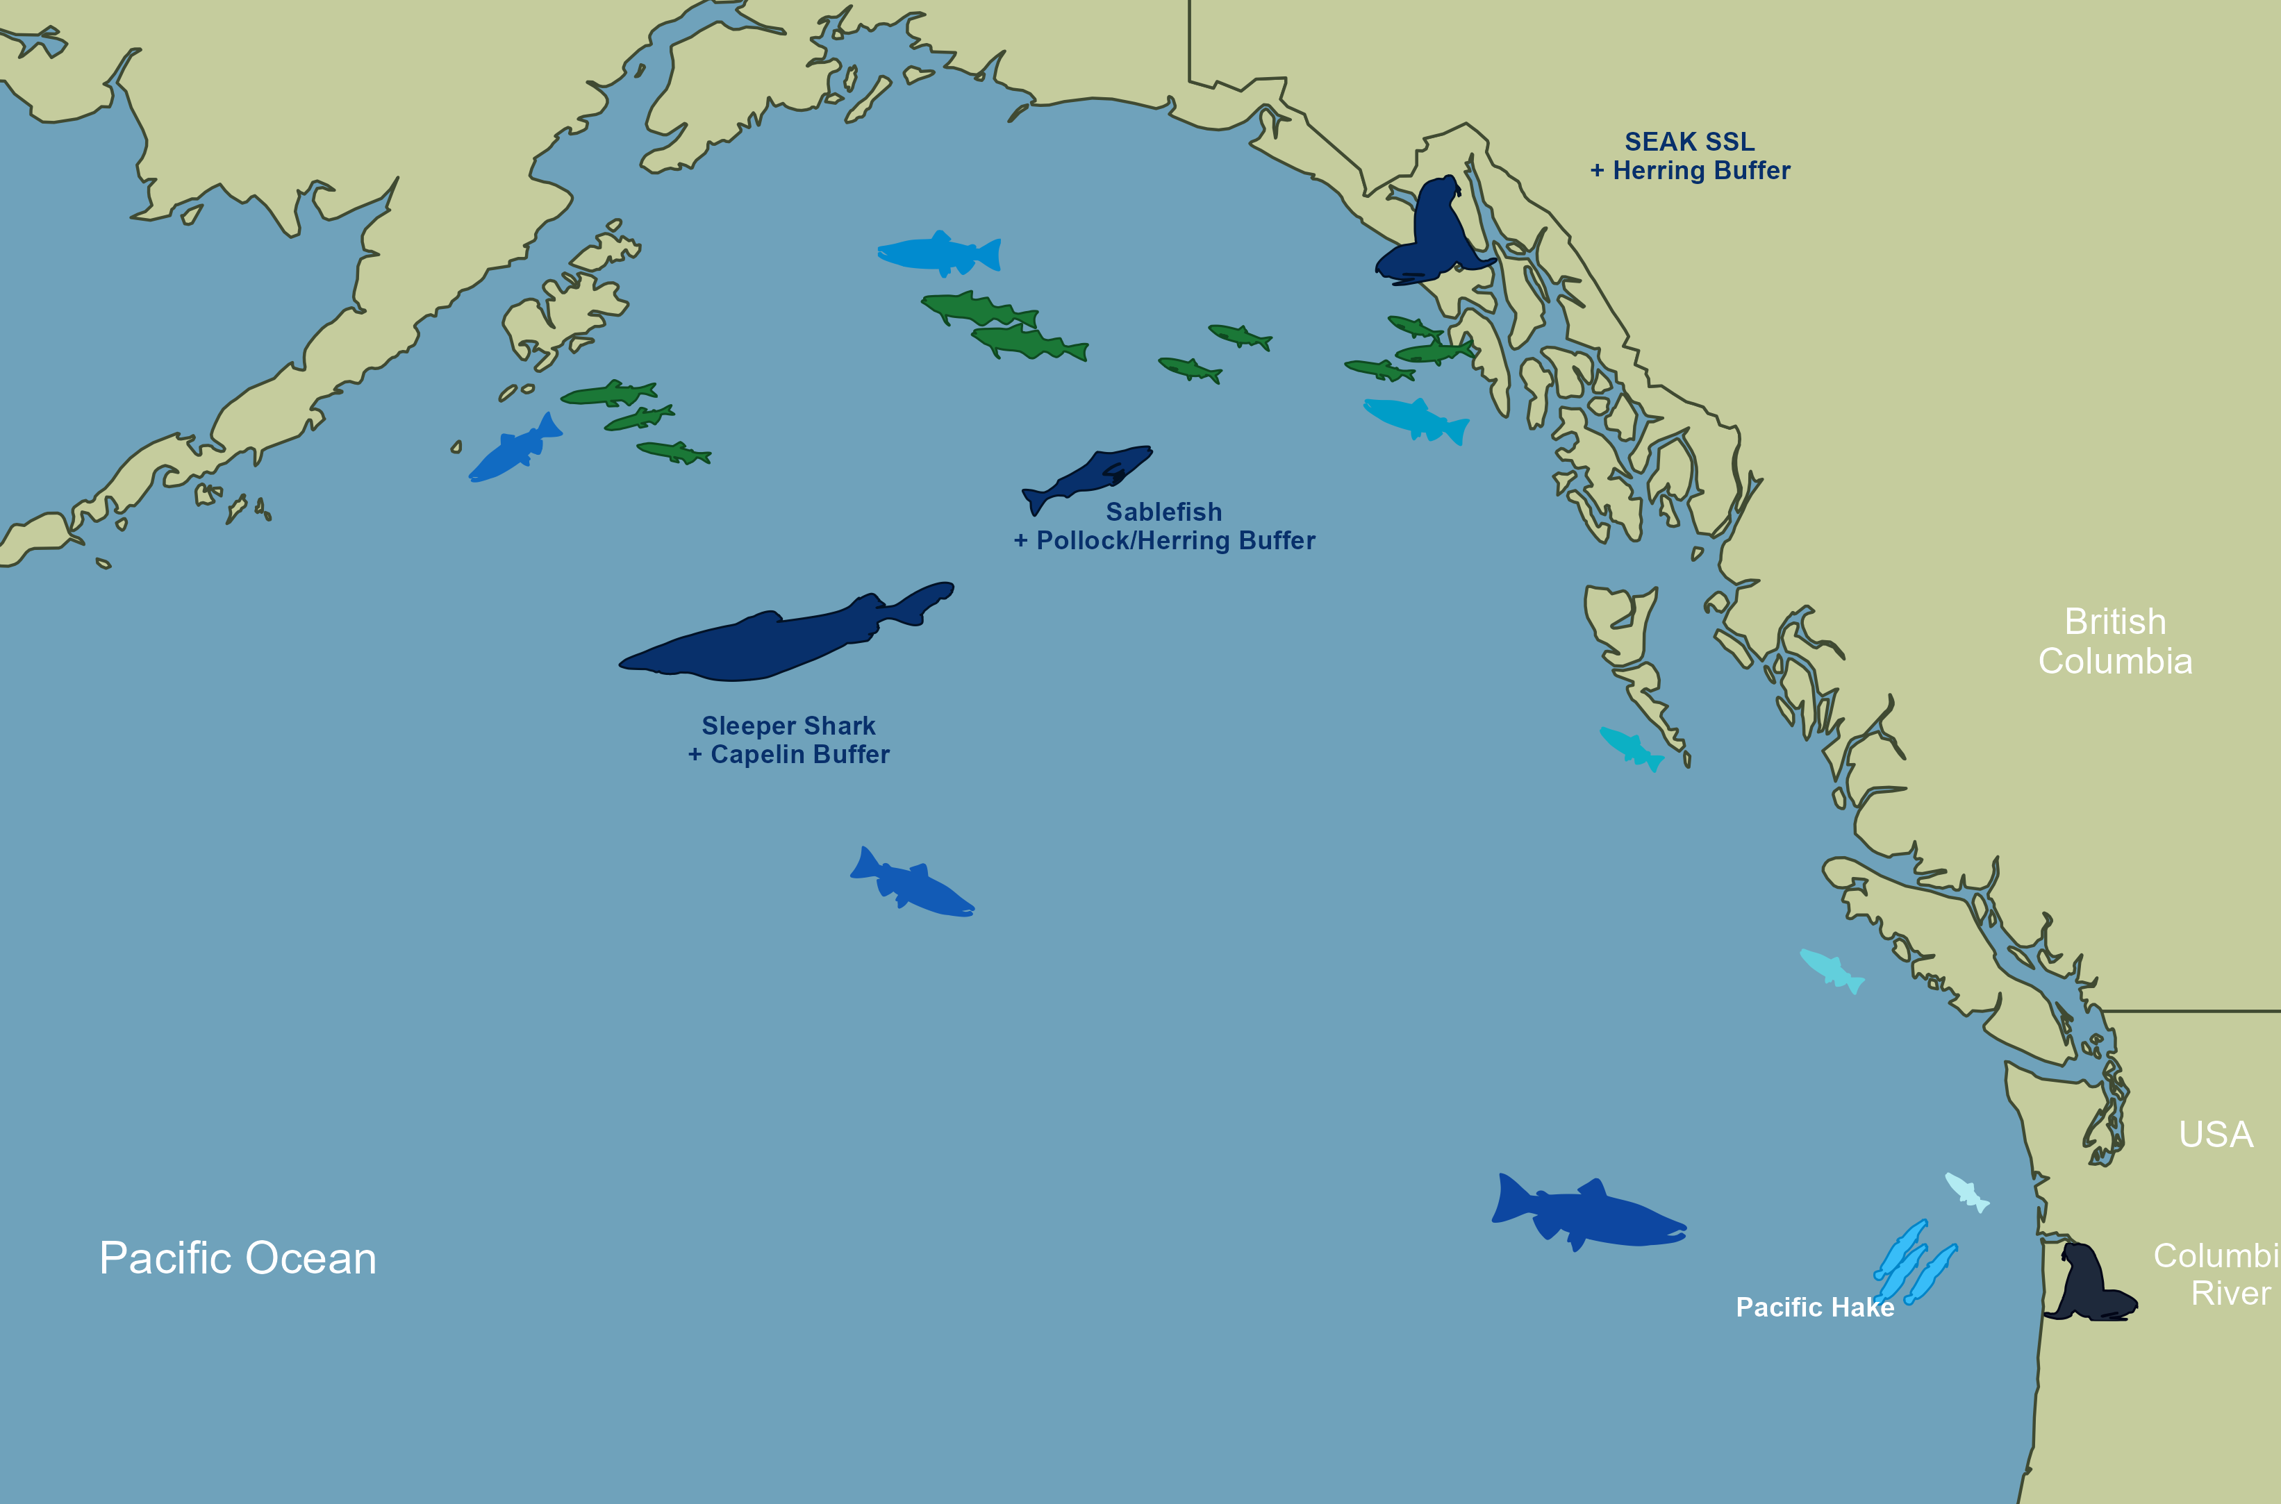
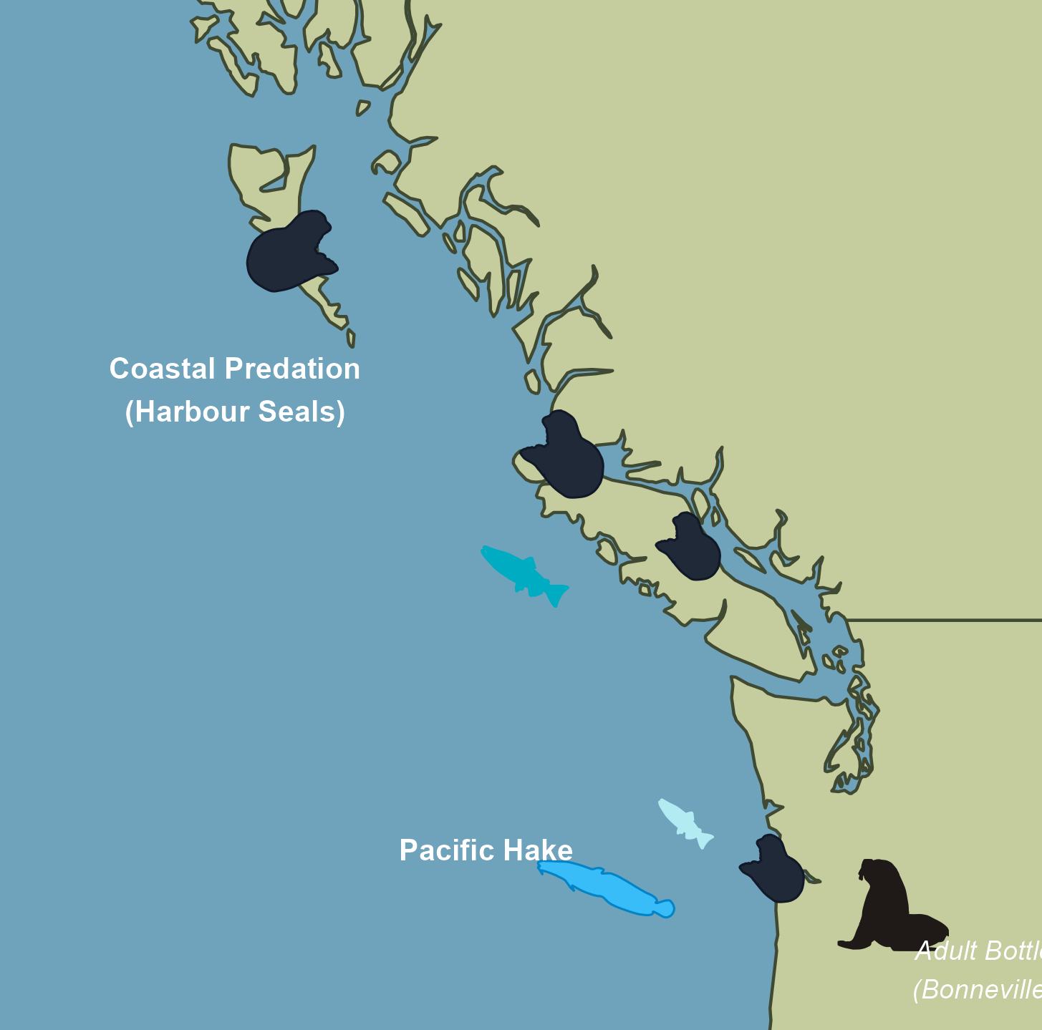
Results – multiple candidate models
Next steps: refine models (plausibility, spatial specificity), extend to individual SEM (freshwater effects, Eve Pugsley, UW)
Notes:
# predator base_aic abs_final_aic base_beta abs_beta_peff base_r2 abs_final_r2 abs_variant_type abs_prey # 1 X15_DFA_sleeperSharkBSAI_predAK_smoltyr -26.4 -29.8 -0.246 -0.593 0.481 0.556 Joint Temp + 1 AltPrey capelin_WGoA_smoltyr # 2 X10_Harbour_s_WS_adultyr -29.0 -29.0 -0.530 -0.530 0.516 0.516 Raw Baseline None # 3 X15_sablefishAK_biomass4plus_smoltyr -25.6 -28.8 0.420 -2.03 0.466 0.540 Joint Temp + 1 AltPrey sitkaHerring_EGoA_smoltyr # 4 X15_sablefishAK_biomass3plus_smoltyr -27.6 -28.8 0.504 -2.41 0.519 0.534 Joint Temp + 2 AltPrey X13_pollockGOA_age1and2_smoltyr + sitkaHerring_EGoA_smoltyr# 5 X10_harbour_seal_DFO_Coastwide_smoltyr -27.3 -28.7 -0.314 -0.486 0.506 0.534 Temp Only None # 6 X11_ssl_seak_pup_pred_smoltyr -23.1 -27.1 0.122 -0.583 0.393 0.491 Joint Temp + 2 AltPrey sitkaHerring_EGoA_smoltyr + capelin_WGoA_smoltyr # 7 X15_DFA_halibutBiomassAge8plus_predAK_adultyr -25.1 -26.9 -0.287 -0.509 0.457 0.500 Joint Temp + 1 AltPrey capelin_WGoA_adultyr

Slide 13
CONCLUSIONS
BENEFITS OF REGIONAL SURVEYS & DATA SHARING
Allows characterization of WA coast, WCVI, BC coast, and AK species interactions
Improved “limiting factor” identification, despite regional correlations
DFAs often combine data from different regions that were + and - correlated –> more questions!!!
AK PREDATORS EXPLAIN SUBSTANTIAL VARIATION IN SALMON SURVIVAL
Experiments and more insights needed to prove causal relationships

Slide 14
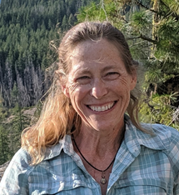

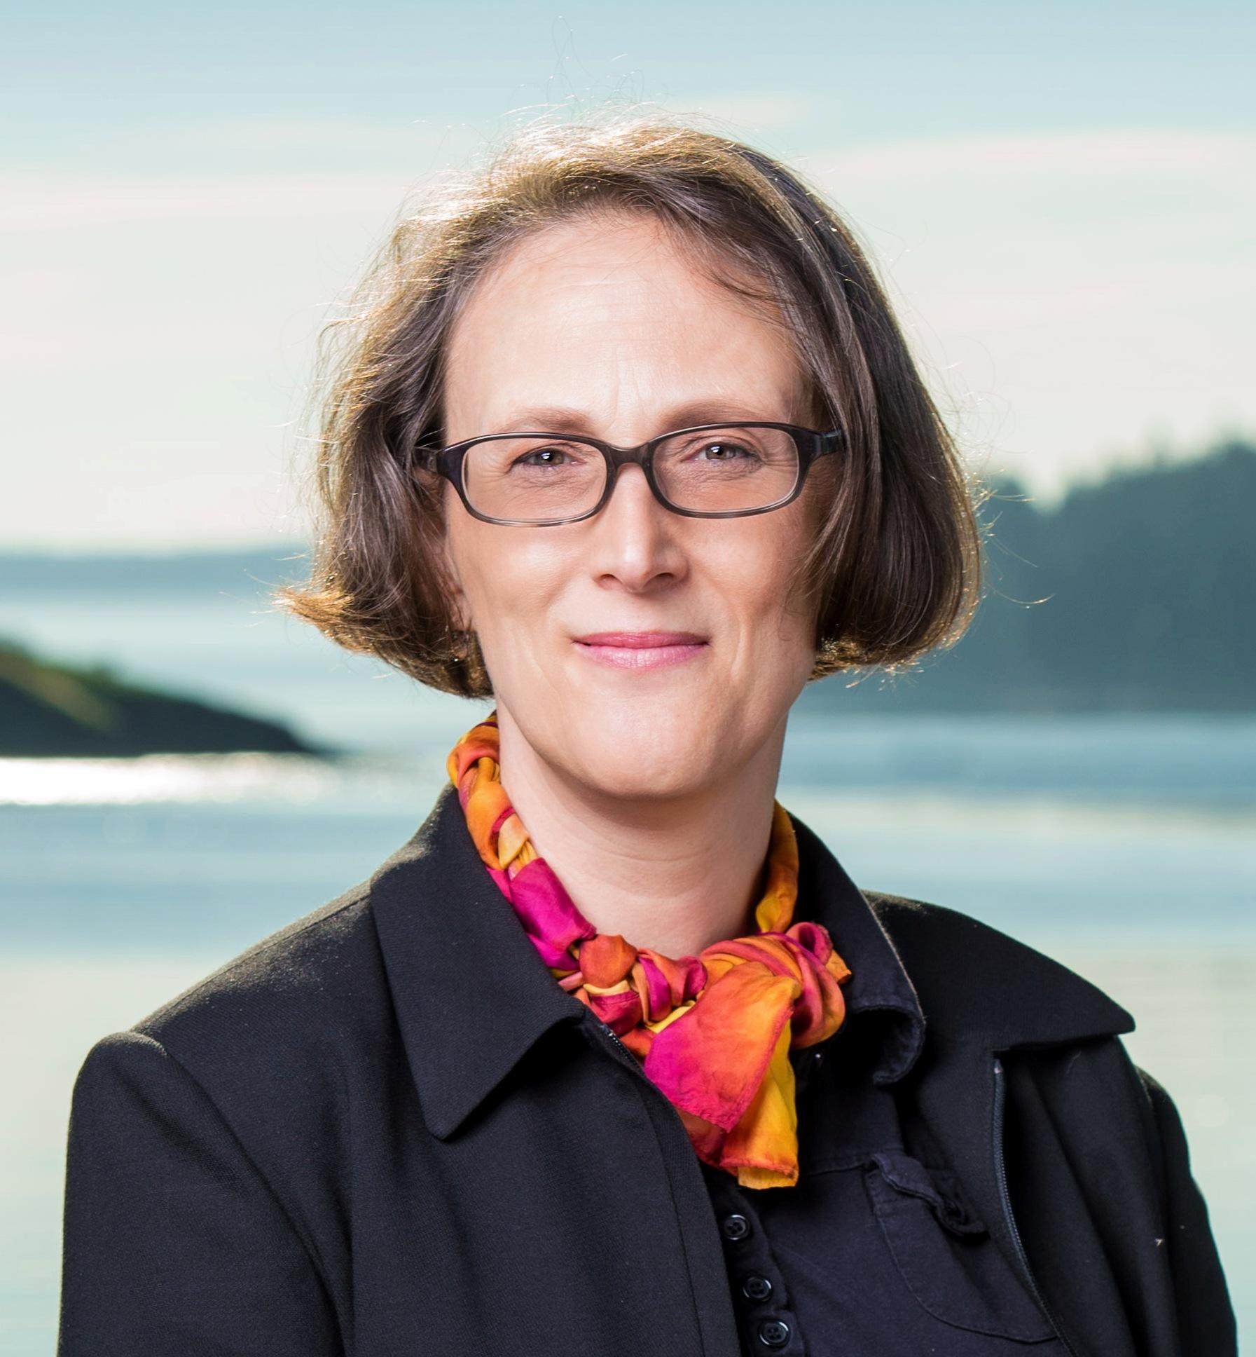


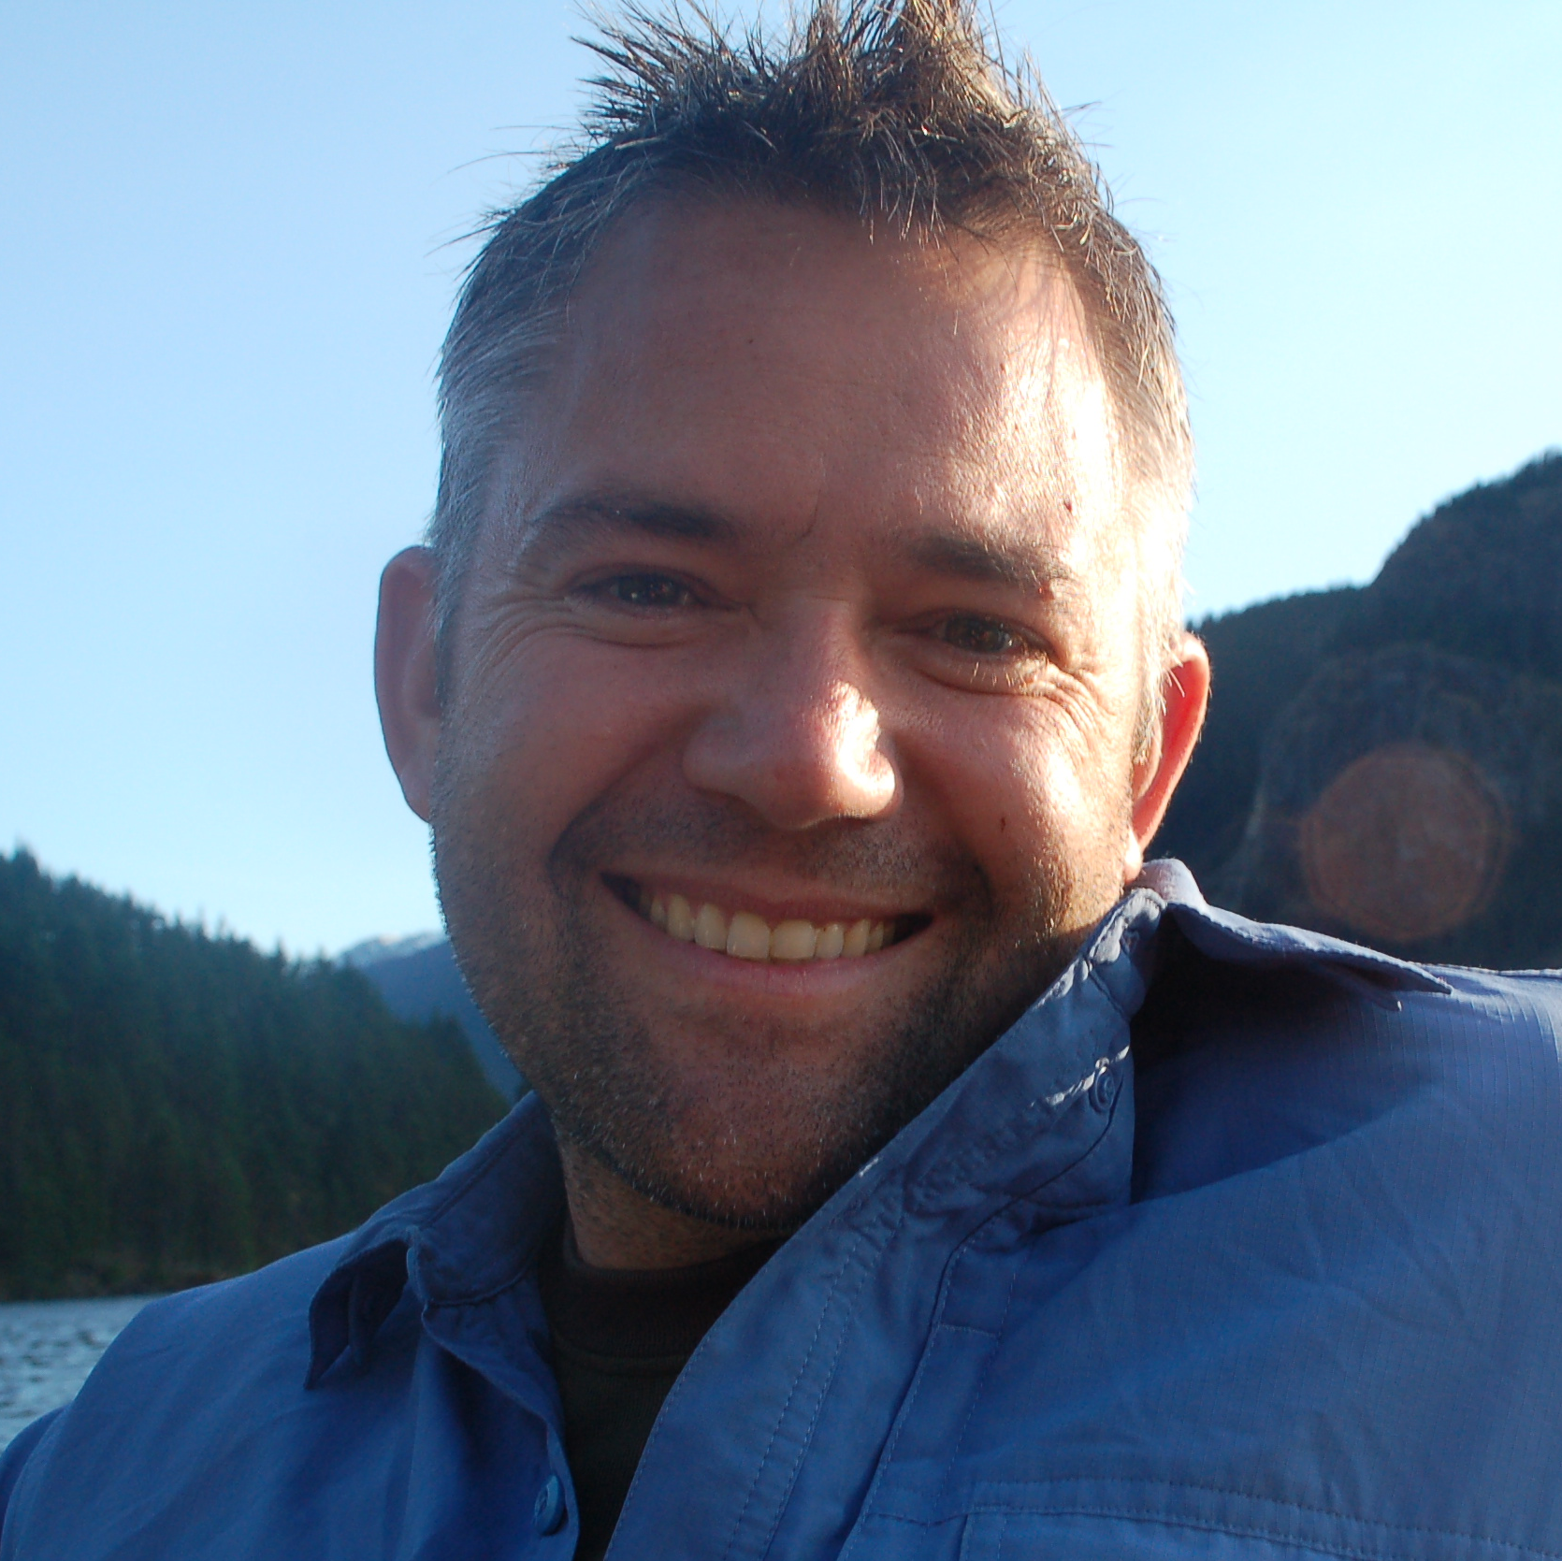
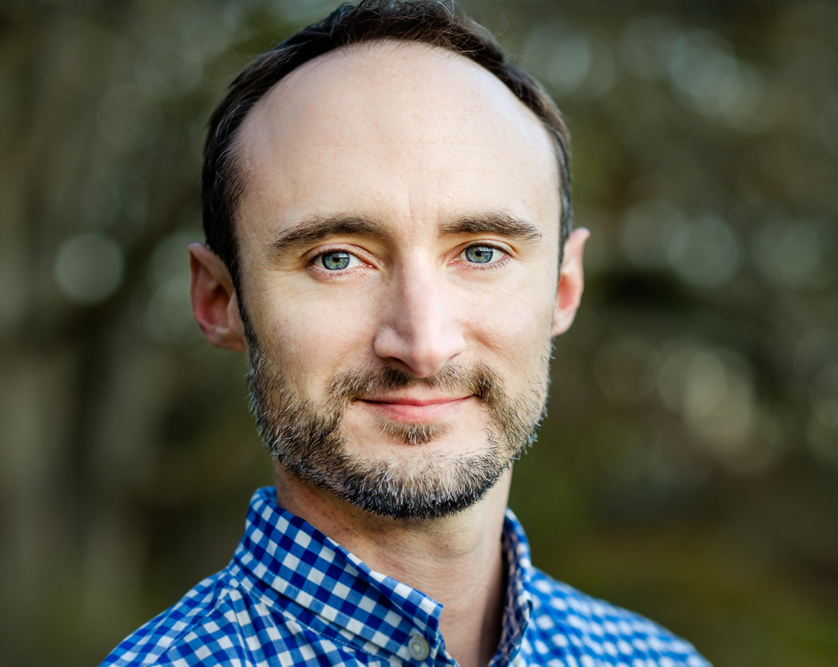
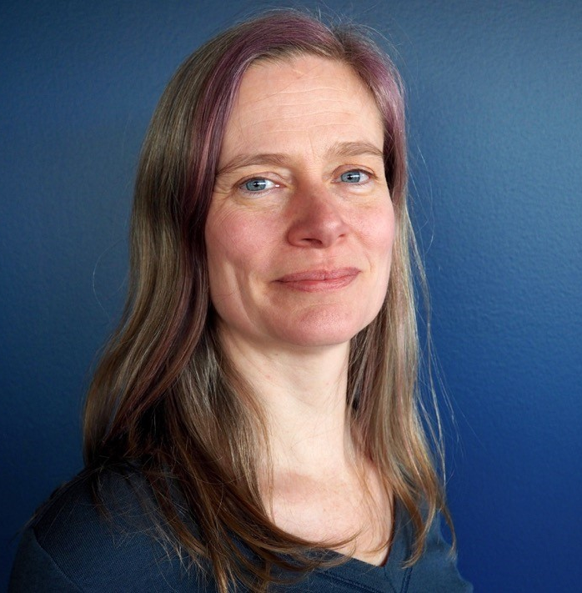
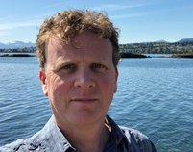

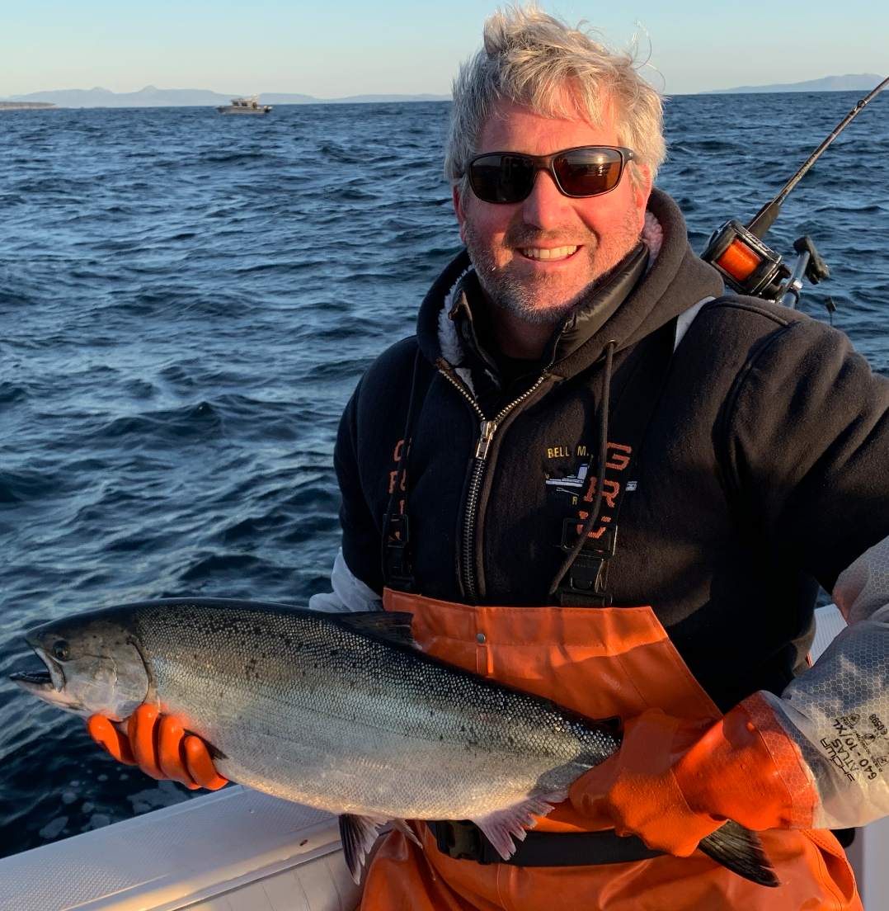

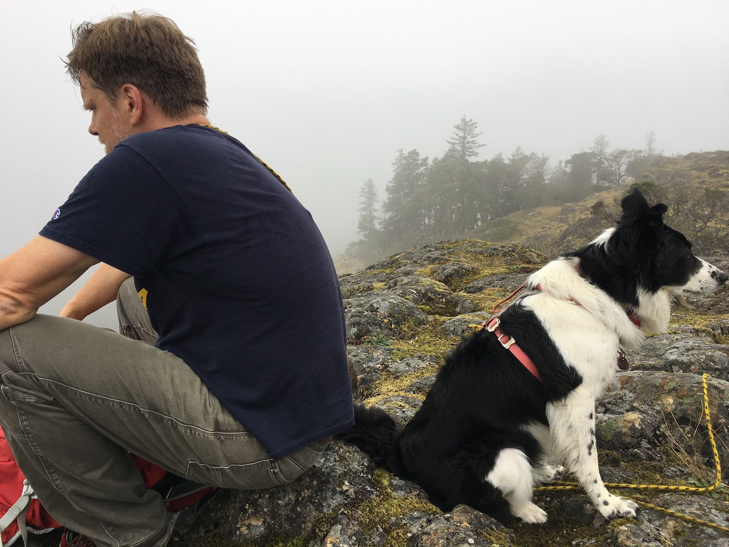





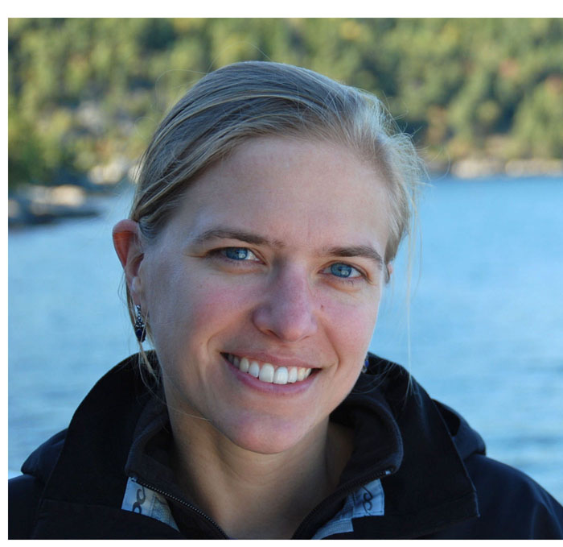

Thank you – DFO/NMFS Climate and Fisheries Collaboration
Pacific working group membership!
AK ESR DFAs
Mammal models
Groundfish/dogfish
DFO Juv salmon survey
Climate Vuln Ass
Lisa Crozier (NWFSC)
Bridget Ferris (AFSC)
Sean Anderson (DFO)
Jackie King (DFO)
Paul Spencer (AFSC)
Mary Hunsicker (NWFSC)
Eric Ward (NWFSC)
AK ESR
Pacea R Pkg
ocean data wrangler
Co-author, bird/mammal data wrangler
MOM ocean projections
Chris Rooper (DFO)
Tetjana Ross (DFO)
Andy Edwards (DFO)
Kiva Oken (NWFSC)
David Huff (NWFSC)
Mike Jacox (SWFS/OAR)
Int Pelagic survey Herring data
Salmon and sablefish
AK larval fish
Cam Freshwater (DFO)
Co-author, data wrangler
AK salmon surveys
Lauren Rogers (AFSC)
Wei Cheng (AFSC/PMEL)
Jennifer Boldt (DFO)
Brendan Connors (DFO)
Angelica Pena (DFO)
BCCM ocean model incl CR
Wess Strasburger (AFSC)
Researchers on JSOES, NHL, Hake, Coastal Pelagic Surveys,WCGFS, mammals (ODFW, WDFW, ACOE) and birds (Yaq., WA, AK)

